Slide 1
Kubernetes in Action
Part IX
2026.08.25

Slide 2
Advanced Scheduling

Slide 3
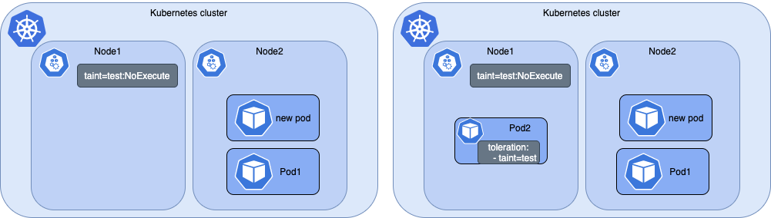
Using Taints and Tolerations(1/11)
Taints and Tolerations :
  The first two features related to advanced scheduling that we’ll explore here are the node taints and pods’ tolerations of those taints. They’re used for restricting which pods can use a certain node. A pod can only be scheduled to a node if it tolerates the node’s taints.
  This is somewhat different from using node selectors and node affinity. Node selectors and node affinity rules make it possible to select which nodes a pod can or can’t be scheduled to by specifically adding that information to the pod, whereas taints allow rejecting deployment of pods to certain nodes by only adding taints to the node without having to modify existing pods. Pods that you want deployed on a tainted node need to opt in to use the node, whereas with node selectors, pods explicitly specify which node(s) they want to be deployed to.

Slide 4
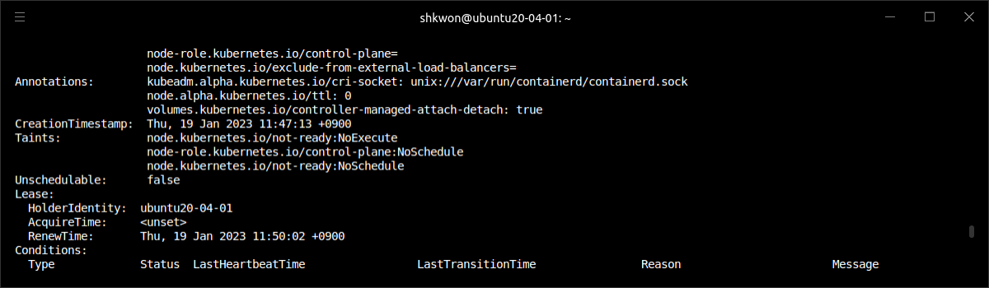
Using Taints and Tolerations(2/11)
Introducing Taints and Tolerations :
  The best path to learn about node taints is to see an existing taint. You can set up a multi-node cluster with the “kubeadm” tool. By default, the master node in such a cluster is tainted, so only “Control Plane” pods can be deployed on it.
  You can see the node’s taints using “$ kubectl describe node” command, as shown in the following listing.
$ sudo kubeadm init --apiserver-advertise-address 192.168.0.229 --pod-network-cidr=172.16.0.0/16
$ sudo cp -i /etc/kubernetes/admin.conf $HOME/.kube/config
$ sudo chown $(id -u):$(id -g) $HOME/.kube/config
$ kubectl describe node

Slide 5
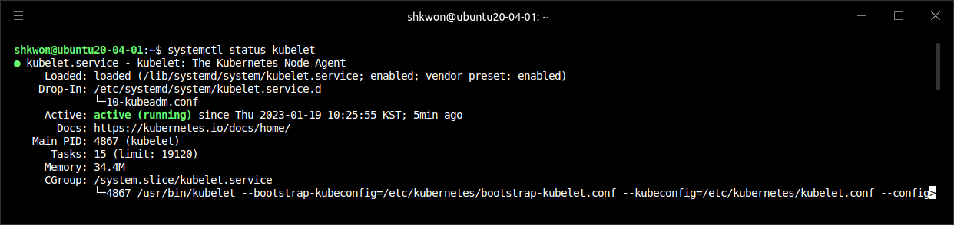
NOTE : Trouble Shooting in Creating Kubernetes Cluster(1/3)
Running Your Own Cluster :
  When I am trying to use the kubelet version 1.26.0 in my VirtualBox machine, I cannot run the kubelet service. In this case, I downgraded the kubelet version into 1.25.X with the following command. And restart the service.
  NOTE : If you don’t want to upgrade the Kubernetes packages, you can run the “$ sudo apt-mark hold kubelet kubeadm kubectl” command.
  NOTE : If you want to see logs from the “kubelet” dameon, you can run the “$ journalctl -u kubelet” command.
$ sudo apt remove --purge kubelet
$ sudo apt install -y kubeadm kubelet=1.25.5-00
$ sudo systemctl daemon-reload
$ sudo systemctl restart kubelet
$ systemctl status kubelet

Slide 6
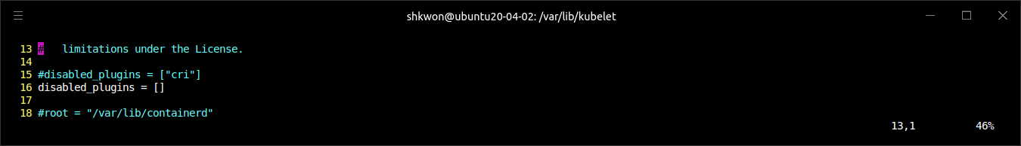
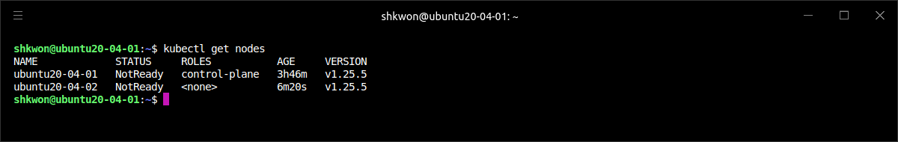
NOTE : Trouble Shooting in Creating Kubernetes Cluster(2/3)
Joining the Cluster :
  When you meet an error like “[ERROR CRI] …”, you need to change “/etc/container/config.toml” like the following.
  Then, restart the containerd daemon using the “$ sudo systemctl restart containerd” command.
  After this, you can join the cluster with the following command in the worker node.
  In the master node, now you can find the joined worker node with “$ kubectl get nodes” command.
$ sudo kubeadm join 192.168.0.229:6443 --token l4itae.rk7fgfh1f9z9a86n --discovery-token-ca-cert-hash sha256:b15a020f35ac768f9ee92b946e706533d674f4e06008afc98b3696382c937965

Slide 7
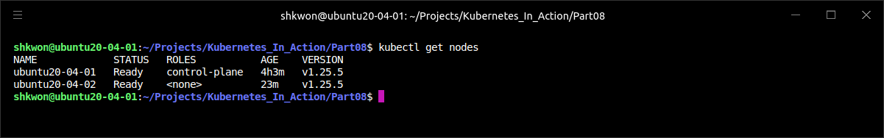
NOTE : Trouble Shooting in Creating Kubernetes Cluster(3/3)
Node Not Ready :
  When you run “$ kubectl get node” command and find that the worker node is “Not Ready”, then you need to find out the reason. Run “$ kubectl describe <node-name>” command and find the reason. If the reason is “CNI plugin not installed”, then run the following command.
  NOTE : Here I used “Weave Net” CNI plugin for CNI(Container Network Interface). In case of flannel CNI plugin, I met an error like “/run/flannel/setup.env file not found”(2023.01).
  For more information about Weave Net, refer to https://www.weave.works/docs/net/latest/kubernetes/kube-addon/.
  NOTE : In the worker node, when you run “$ sudo kubeadm join xxx” command and pending in “preflight check”, then you need to run the “$ sudo kubeadm init” command in master node and run “$ sudo kubeamin join xxx” command again.
$ kubectl apply -f https://github.com/weaveworks/weave/releases/download/v2.8.1/weave-daemonset-k8s.yaml

Slide 8
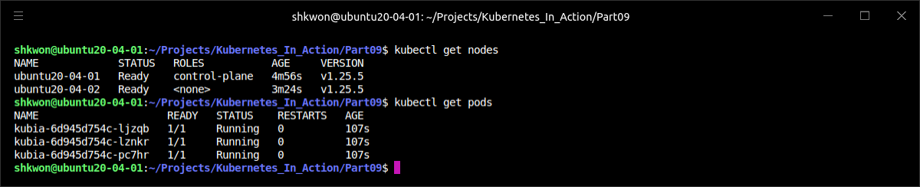
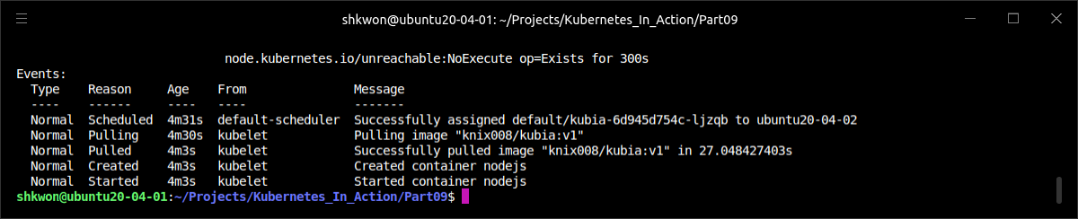
NOTE : Running Pods in Cluster
Checking the Cluster :
  To check the cluster, we can try to create pods using “$ kubectl create -f deployment.yaml” command. Then you can use “$ kubectl describe pod <Pod Name>” command.
  As you can see from the above screenshot, the pods are scheduled on “ubuntu20-04-02” node.

Slide 9
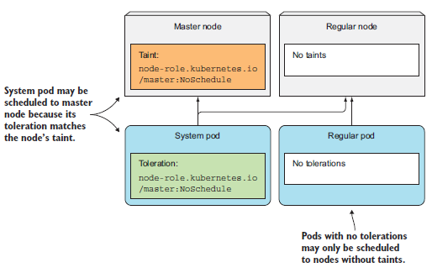
Using Taints and Tolerations(3/11)
Introducing Taints and Tolerations :
  The master node can have several taints. Taints have a key, value, and an effect, and are represented as “<key>=<value>:<effect>”. The master node’s taint shown in the previous listing has the key node-role.kubernetes.io/control-plane, and the effect of NoSchedule.
  This taint prevents pods from being scheduled to the control-plane, unless those pods tolerate this taint. The pods that tolerate it are usually system pods (see the following figure).
  NOTE : In the figure, the taint is like “node-role.Kubernetes.io/master:NoSchedule” in Master node.

Slide 10
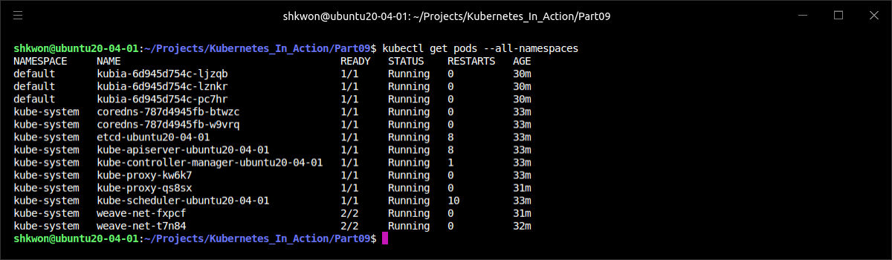
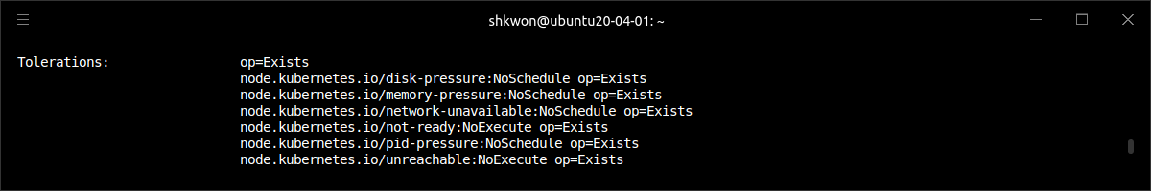
Using Taints and Tolerations(4/11)
Introducing Taints and Tolerations :
  In a cluster installed with kubeadm, the kube-proxy cluster component runs as a pod on every node, including the master node, because master components that run as pods may also need to access Kubernetes Services. To make sure the kube-proxy pod also runs on the master node, it includes the appropriate toleration.

Slide 11
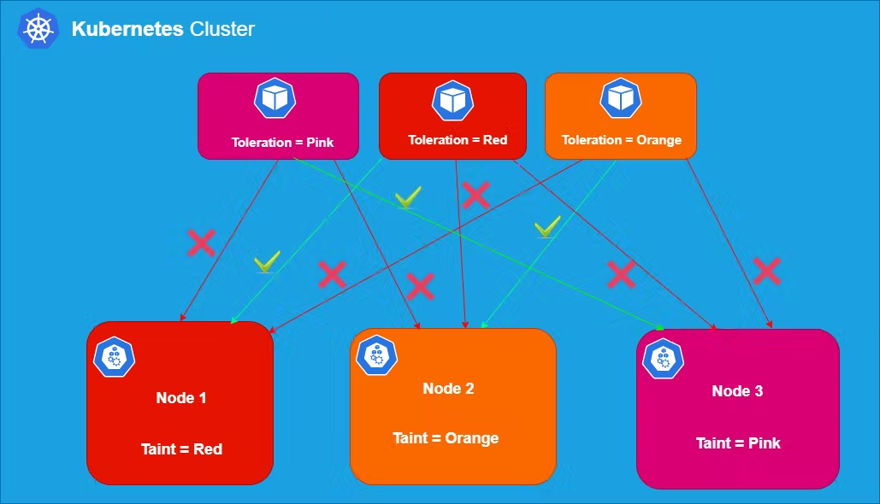
Using Taints and Tolerations(5/11)
Introducing Taints and Tolerations :
  The other tolerations on the kube-proxy pod define how long the pod is allowed to run on nodes that aren’t ready or are unreachable (the time in seconds isn’t shown, but can be seen in the pod’s YAML). Those tolerations refer to the NoExecute instead of the NoSchedule effect.
  Each taint has an effect associated with it. Three possible effects exist :
    NoSchedule, which means pods won’t be scheduled to the node if they don’t tolerate the taint.
    PreferNoSchedule is a soft version of NoSchedule, meaning the scheduler will try to avoid scheduling the pod to the node, but will schedule it to the node if it can’t schedule it somewhere else.
    NoExecute, unlike NoSchedule and PreferNoSchedule that only affect scheduling, also affects pods already running on the node. If you add a NoExecute taint to a node, pods that are already running on that node and don’t tolerate the NoExecute taint will be evicted from the node.

Slide 12
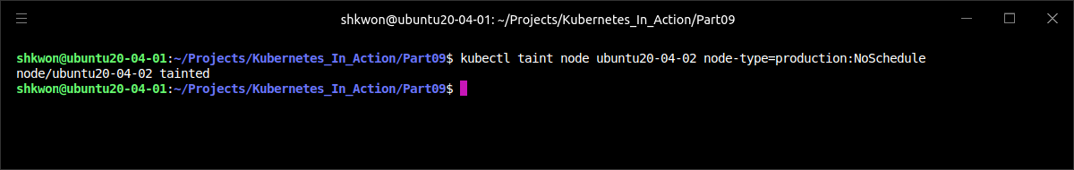
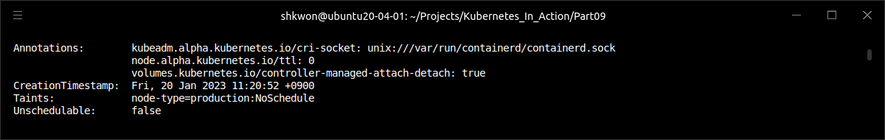
Using Taints and Tolerations(6/11)
Adding Custom Taints to a Node :
  Imagine having a single Kubernetes cluster where you run both production and nonproduction workloads. It’s of the utmost importance that non-production pods never run on the production nodes. This can be achieved by adding a taint to your production nodes. To add a taint, you use the “$ kubectl taint” command :
  NOTE : This adds a taint with key “node-type”, value “production” and the “NoSchedule” effect.
  NOTE : To untaint, you can use the “$ kubectl taint node ubuntu20-04-02 node-type=production:NoSchedule-” command. Add the “-” at the end of the same command.
$ kubectl taint node ubuntu20-04-02 node-type=production:NoSchedule
$ kubectl describe node ubuntu20-04-02

Slide 13
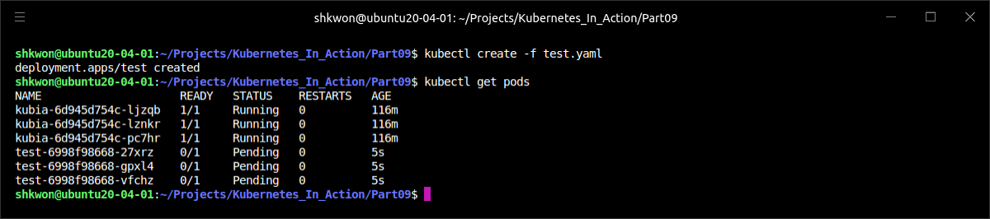
Using Taints and Tolerations(7/11)
Adding Custom Taints to a Node :
  If you now deploy multiple replicas of a regular pod, you’ll see none of them are scheduled to the node you tainted, as shown in the following listing.
  NOTE : As you can see from the above screenshot, the “test-xxx-xxx” pods are pending. Those pods are not schedulable in worker nodes now because of the taints for “ubuntu20-04-02” node. Only “production” can be schedulable on that node.
$ kubectl create -f test.yaml
$ kubectl get pods -o wide

Slide 14
Using Taints and Tolerations(8/11)
Adding Tolerations to Pods :
  To deploy production pods to the production nodes, they need to tolerate the taint you added to the nodes. The manifests of your production pods need to include the YAML snippet shown in the following listing.
  NOTE : To prevent a pod deployed to a non-production node, you’d also need to taint the non-production nodes with a taint such as “node-type=non-production:NoSchedule”.
apiVersion: apps/v1
kind: Deployment
metadata:
name: prod
spec:
replicas: 5
template:
metadata:
labels:
app: prod
spec:
containers:
- args:
- sleep
- "99999"
image: busybox
name: main
tolerations:
- key: node-type
operator: Equal
value: production
effect: NoSchedule
production-deployment.yaml

Slide 15
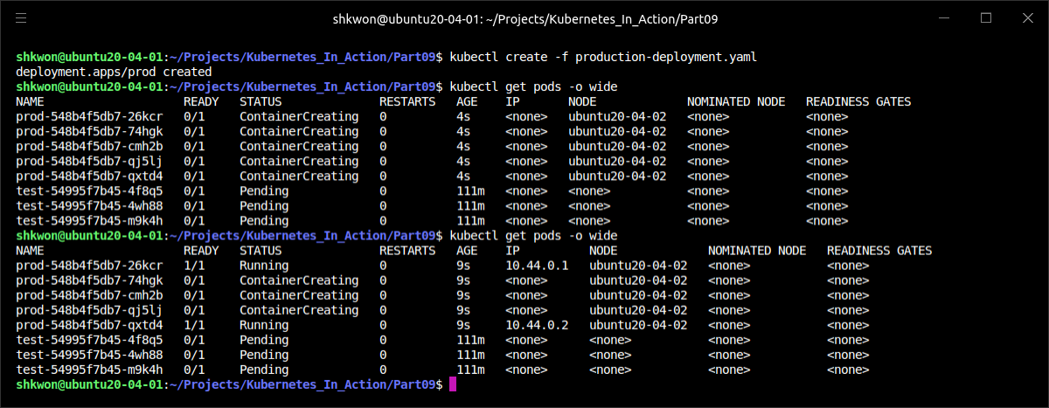
Using Taints and Tolerations(9/11)
Adding Tolerations to Pods :
  If you deploy the previous Deployment, you’ll see its pods get deployed to the production node, as shown in the next screenshot.
$ kubectl create -f production-deployment.yaml

Slide 16
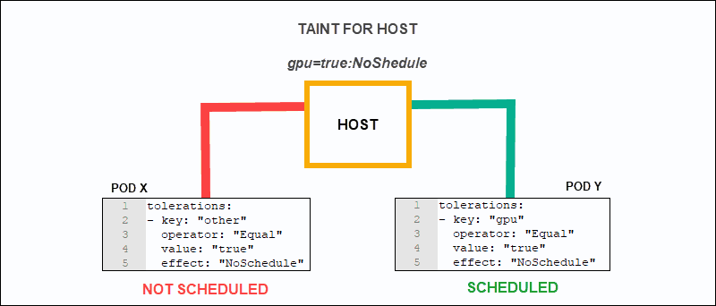
Using Taints and Tolerations(10/11)
Understanding What Taints and Tolerations Can Be Used for :
  Nodes can have more than one taint and pods can have more than one toleration. As you’ve seen, taints can only have a key and an effect and don’t require a value. Tolerations can tolerate a specific value by specifying the Equal operator (that’s also the default operator if you don’t specify one), or they can tolerate any value for a specific taint key if you use the “Exists” operator.
  Taints can be used to prevent scheduling of new pods (NoSchedule effect) and to define unpreferred nodes (PreferNoSchedule effect) and even evict existing pods from a node (NoExecute).
  You can set up taints and tolerations any way you see fit. For example, you could partition your cluster into multiple partitions, allowing your development teams to schedule pods only to their respective nodes. You can also use taints and tolerations when several of your nodes provide special hardware and only part of your pods need to use it.
  NOTE : For more information, refer to https://kubernetes.io/docs/concepts/scheduling-eviction/taint-and-toleration/.

Slide 17
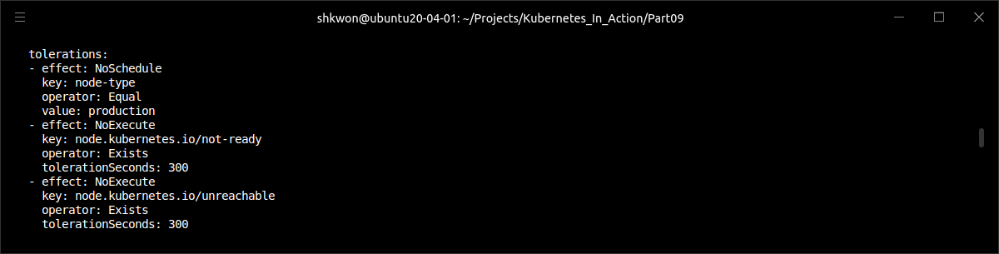
Using Taints and Tolerations(11/11)
Understanding What Taints and Tolerations Can Be Used for :
  You can also use a toleration to specify how long Kubernetes should wait before rescheduling a pod to another node if the node the pod is running on becomes unready or unreachable. If you look at the tolerations of one of your pods, you’ll see two tolerations, which are shown in the following listing.
  These two tolerations say that this pod tolerates a node being notReady or unreachable for 300 seconds. The Kubernetes Control Plane, when it detects that a node is no longer ready or no longer reachable, will wait for 300 seconds before it deletes the pod and reschedules it to another node.
  These two tolerations are automatically added to pods that don’t define them. If that five-minute delay is too long for your pods, you can make the delay shorter by adding those two tolerations to the pod’s spec
kubectl get pod prod-548b4f5db7-26kcr -o yaml

Slide 18
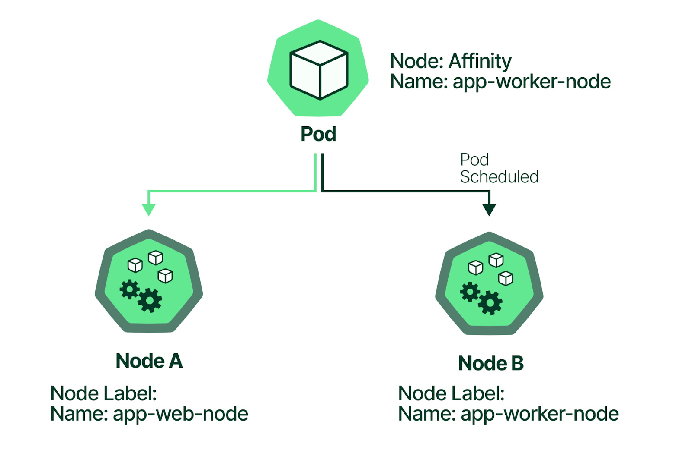
Using Node Affinity(1/12)
What is Node Affinity? :
  Taints are used to keep pods away from certain nodes. Now you’ll learn about a newer mechanism called node affinity, which allows you to tell Kubernetes to schedule pods only to specific subsets of nodes.
  The initial node affinity mechanism in early versions of Kubernetes was the “nodeSelector” field in the pod specification. The node had to include all the labels specified in that field to be eligible to become the target for the pod.
  Node selectors get the job done and are simple, but they don’t offer everything that you may need. Because of that, a more powerful mechanism was introduced. Node selectors will eventually be deprecated, so it’s important you understand the new node affinity rules.
  Similar to node selectors, each pod can define its own node affinity rules. These allow you to specify either hard requirements or preferences. By specifying a preference, you tell Kubernetes which nodes you prefer for a specific pod, and Kubernetes will try to schedule the pod to one of those nodes. If that’s not possible, it will choose one of the other nodes.

Slide 19
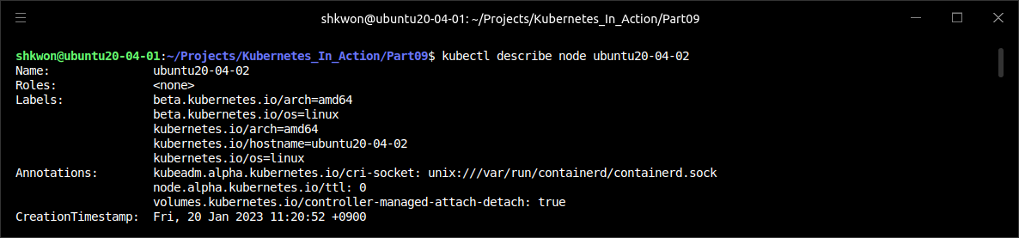
Using Node Affinity(2/12)
What is Node Affinity? :
  Node affinity selects nodes based on their labels, the same way node selectors do. Before you see how to use node affinity, let’s examine the labels of one of the nodes to see what the default node labels are. They’re shown in the following listing.
  You already learned how you can add a custom label to nodes and use it in a pod’s node selector. You used the custom label to deploy pods only to nodes with that label by adding a node selector to the pods.
$ kubectl describe node ubuntu20-04-02

Slide 20
Using Node Affinity(3/12)
Specifying Hard Node Affinity Rules :
  You used the node selector to deploy a pod that requires a GPU only to nodes that have a GPU before. The pod spec included the “nodeSelector” field shown in the following listing.
  The “nodeSelector” field specifies that the pod should only be deployed on nodes that include the “gpu=true” label. If you replace the node selector with a node affinity rule, the pod definition will look like the following listing.
apiVersion: v1
kind: Pod
metadata:
name: kubia-gpu
spec:
nodeSelector:
gpu: "true"
containers:
- image: knix008/kubia
name: kubia
kubia-gpu-nodeselector.yaml
apiVersion: v1
kind: Pod
metadata:
name: kubia-gpu
spec:
affinity:
nodeAffinity:
requiredDuringSchedulingIgnoredDuringExecution:
nodeSelectorTerms:
- matchExpressions:
- key: gpu
operator: In
values:
- "true“
…
kubia-gpu-nodeaffinity.yaml

Slide 21
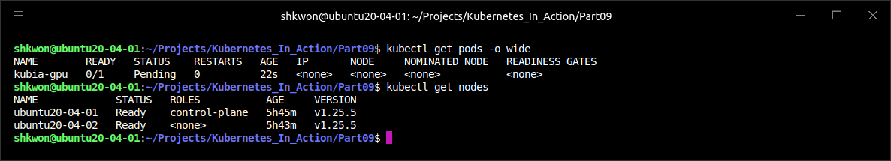
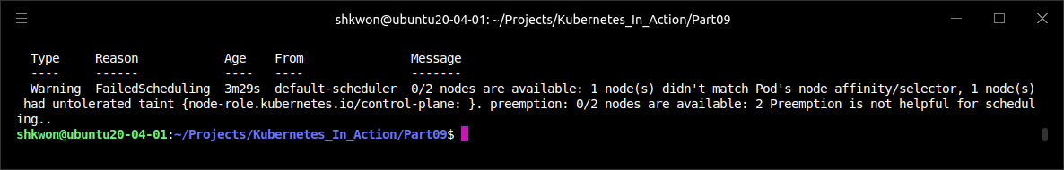
NOTE : Running Pod with NodeSelector
The nodeSelector Field in Pod Spec :
  When you try to run the pod with the “$ kubectl create -f kubia-gpu-nodeselector.yaml” command, you will see the following screenshot.
  NOTE : Before you run the command, you need to untaint the node first.
$ kubectl describe pod kubia-gpu

Slide 22
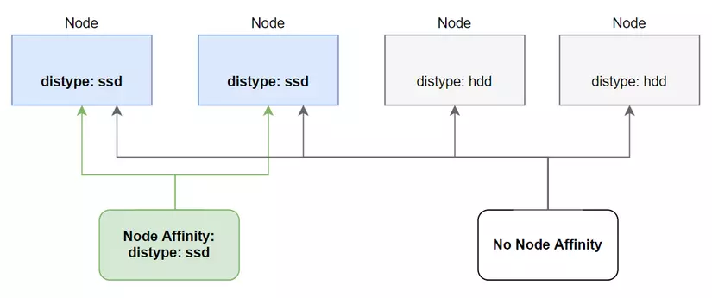
Using Node Affinity(4/12)
Specifying Hard Node Affinity Rules :
  As you can see, the pod’s spec section contains an “affinity” field that contains a “nodeAffinity” field, which contains a field with an extremely long name, so let’s focus on that first.
  Let’s break it down into two parts and examine what they mean :
    “requiredDuringScheduling...” means the rules defined under this field specify the labels the node must have for the pod to be scheduled to the node.
    “...IgnoredDuringExecution” means the rules defined under the field don’t affect pods already executing on the node.
  At this point, affinity currently only affects pod scheduling and never causes a pod to be evicted from a node. That’s why all the rules right now always end with “IgnoredDuringExecution.” Eventually, Kubernetes will also support “RequiredDuringExecution,” which means that if you remove a label from a node, pods that require the node to have that label will be evicted from such a node.

Slide 23
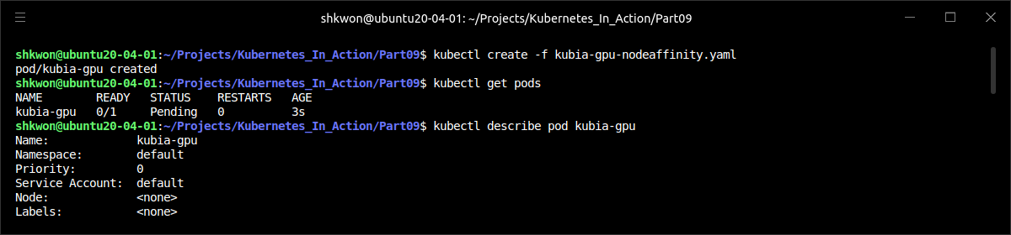
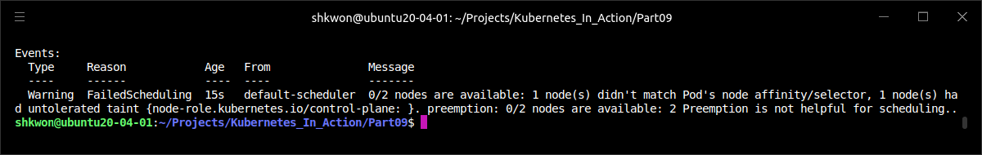
NOTE : Running Pod with NodeAffinity
The nodeAffinity Field in Pod Spec :
  When you run the “kubia-gpu-nodeaffinity.yaml”, you will also meet the pod pending. If you don’t have any node with GPU, then you will meet the pending situation.

Slide 24
Using Node Affinity(5/12)
Specifying Hard Node Affinity Rules :
  The “nodeSelectorTerms” field and the “matchExpressions” field define which expressions the node’s labels must match for the pod to be scheduled to the node. The node must have a “gpu” label whose value is set to true. This pod will therefore only be scheduled to nodes that have the “gpu=true” label, as shown in the following figure.

Slide 25
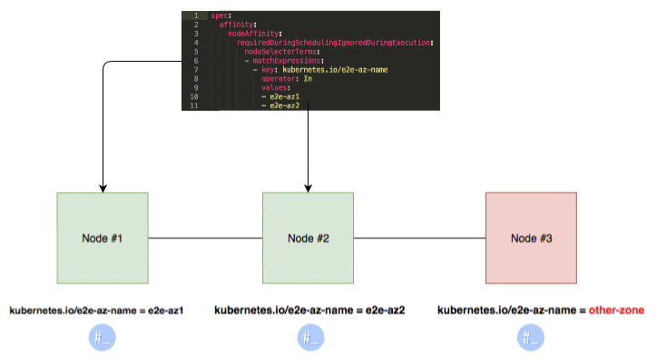
Using Node Affinity(6/12)
Prioritizing Nodes When Scheduling a Pod :
  The biggest benefit of the newly introduced node affinity feature is the ability to specify which nodes the Scheduler should prefer when scheduling a specific pod. This is done through the “preferredDuringSchedulingIgnoredDuringExecution” field.
  Imagine having multiple datacenters across different countries. Each datacenter represents a separate availability zone. In each zone, you have certain machines meant only for your own use and others that your partner companies can use. You now want to deploy a few pods and you’d prefer them to be scheduled to “zone1” and to the machines reserved for your company’s deployments. If those machines don’t have enough room for the pods or if other important reasons exist that prevent them from being scheduled there, you’re okay with them being scheduled to the machines your partners use and to the other zones. Node affinity allows you to do that.

Slide 26
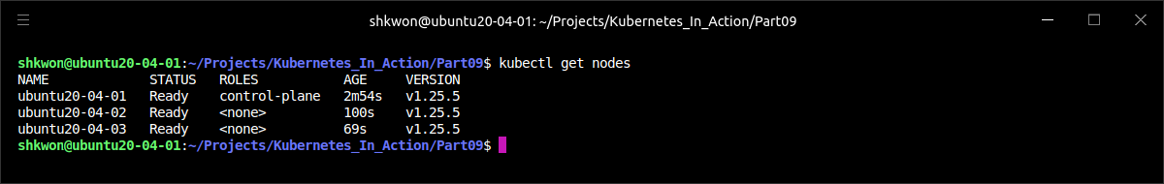
Using Node Affinity(7/12)
Prioritizing Nodes When Scheduling a Pod :
  First, the nodes need to be labeled appropriately. Each node needs to have a label that designates the availability zone the node belongs to and a label marking it as either a dedicated or a shared node.
  NOTE : Minikube isn’t the best choice for running the following examples, because it runs only one node. Here I used “kubeadm” for multi-node cluster. Here I will use only 3 nodes(actually 3 VirtualBox machine), one for “control-plane” and the others for “worker”.
  NOTE : Actually, I made a clone of Virtualbox image and edited “/etc/hosts” file to set the different hostname.
  NOTICE : To refresh the cluster, you need to run “$ sudo kubeadm reset” command in each node. Then “$ sudo kubeadm init” and “$ sudo kubeadm join” commands in master and worker nodes again.
  NOTICE : If you want to reset the cluster, you also need to run “$ kubectl apply -f https://github.com/weaveworks/weave/releases/download/v2.8.1/weave-daemonset-k8s.yaml”.

Slide 27
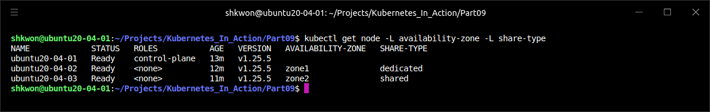
Using Node Affinity(8/12)
Prioritizing Nodes When Scheduling a Pod :
  First, label the nodes, as shown in the next listing.
$ kubectl label node ubuntu20-04-02 availability-zone=zone1
$ kubectl label node ubuntu20-04-02 share-type=dedicated
$ kubectl label node ubuntu20-04-03 availability-zone=zone3
$ kubectl label node ubuntu20-04-02 share-type=shared
$ kubectl get node -L availability-zone -L share-type

Slide 28
Using Node Affinity(9/12)
Prioritizing Nodes When Scheduling a Pod :
  With the node labels set up, you can now create a Deployment that prefers dedicated nodes in “zone1”. The following listing shows the Deployment manifest.
  You’re defining a node affinity preference, instead of a hard requirement. You want the pods scheduled to nodes that include the labels “availability-zone=zone1” and “share-type=dedicated”. You’re saying that the first preference rule is important by setting its weight to “80”, whereas the second one is much less important (weight is set to “20”).
apiVersion: apps/v1
kind: Deployment
metadata:
name: pref
spec:
replicas: 5
template:
metadata:
labels:
app: pref
spec:
affinity:
nodeAffinity:
preferredDuringSchedulingIgnoredDuringExecution:
- weight: 80
preference:
matchExpressions:
- key: availability-zone
operator: In
values:
- zone1
- weight: 20
preference:
matchExpressions:
- key: share-type
operator: In
values:
- dedicated
containers:
- args:
- sleep
- "99999"
image: busybox
name: main
selector:
matchLabels:
app: pref
preferred-deployment.yaml

Slide 29
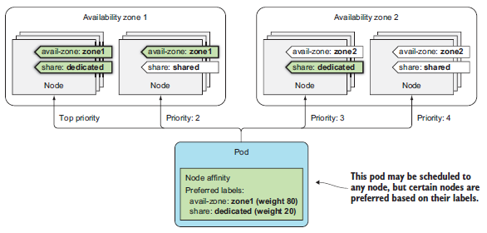
Using Node Affinity(10/12)
Prioritizing Nodes When Scheduling a Pod :
  If your cluster had many nodes, when scheduling the pods of the Deployment in the previous listing, the nodes would be split into four groups, as shown in the following figure. Nodes whose “availability-zone” and “share-type” labels match the pod’s node affinity are ranked the highest. Then, because of how the weights in the pod’s node affinity rules are configured, next come the “shared” nodes in “zone1”, then come the “dedicated” nodes in the other zones, and at the lowest priority are all the other nodes.

Slide 30
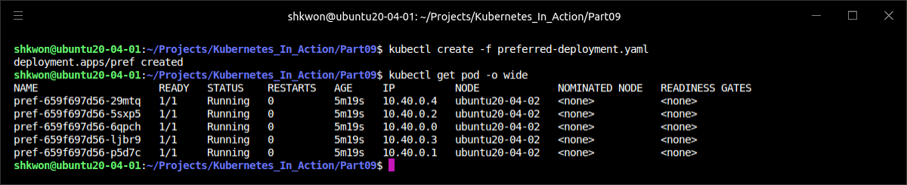
Using Node Affinity(11/12)
Prioritizing Nodes When Scheduling a Pod :
  If you create this Deployment in your “two-node(worker node)” cluster, you should see most (if not all) of your pods deployed to “node1”. Examine the following listing to see if that’s true.
  NOTE : If you meet an error creating the pods, you may need to run “$ kubectl apply -f https://github.com/weaveworks/weave/releases/download/v2.8.1/weave-daemonset-k8s.yaml” command to create network interface for your pods.
$ kubectl create -f preferred-deployment.yaml
$ kubectl get pod -o wide

Slide 31
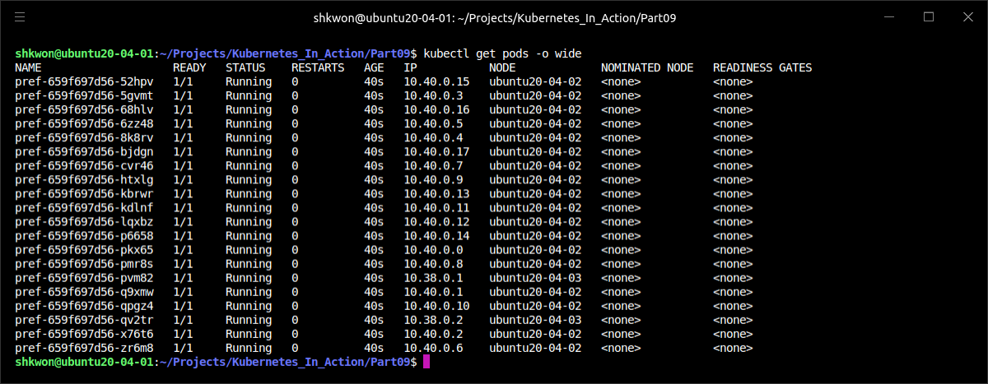
Using Node Affinity(12/12)
Prioritizing Nodes When Scheduling a Pod :
  Sometimes, when you run the previous command, some of pods are created on “ubuntu20-04-03” and others can be created on “ubuntu20-04-02”. The reason is that besides the node affinity prioritization function, the Scheduler also uses other prioritization functions to decide where to schedule a pod. One of those is the “SelectorSpreadPriority” function, which makes sure pods belonging to the same ReplicaSet or Service are spread around different nodes so a node failure won’t bring the whole service down.
  If you hadn’t defined any node affinity preferences, the pods would have been spread around the two nodes evenly. The following screenshot shows that 20 replicas are create in the cluster.

Slide 32
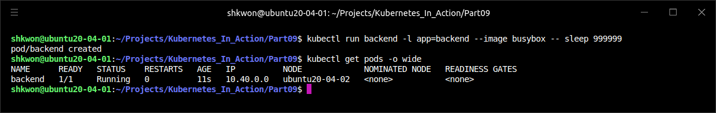
Co-locating Pods with Pod Affinity and Anti-affinity(1/15)
Using Inter-pod Affinity to Deploy Pods on the Same Node :
  You’ve seen how node affinity rules are used to influence which node a pod is scheduled to. But these rules only affect the affinity between a pod and a node, whereas sometimes you’d like to have the ability to specify the affinity between pods themselves.
  For example, imagine having a frontend and a backend pod. Having those pods deployed near to each other reduces latency and improves the performance of the app. You could use node affinity rules to ensure both are deployed to the same node, rack, or datacenter, but then you’d have to specify exactly which node, rack, or datacenter to schedule them to, which is not the best solution. It’s better to let Kubernetes deploy your pods anywhere it sees fit, while keeping the frontend and backend pods close together. This can be achieved using pod affinity.
  You’ll deploy a backend pod and five frontend pod replicas with pod affinity configured so that they’re all deployed on the same node as the backend pod. First, deploy the backend pod:
$ kubectl run backend -l app=backend --image busybox -- sleep 999999

Slide 33
Co-locating Pods with Pod Affinity and Anti-affinity(2/15)
Using Inter-pod Affinity to Deploy Pods on the Same Node :
  The only thing you need to note in the previous example is the “app=backend” label you added to the pod using the “-l” option. This label is what you’ll use in the frontend pod’s podAffinity configuration.
  The frontend pod’s definition is shown in the following listing.
apiVersion: apps/v1
kind: Deployment
metadata:
name: frontend
spec:
replicas: 5
template:
metadata:
labels:
app: frontend
spec:
affinity:
podAffinity:
requiredDuringSchedulingIgnoredDuringExecution:
- topologyKey: kubernetes.io/hostname
labelSelector:
matchLabels:
app: backend
containers:
- name: main
image: busybox
args:
- sleep
- "99999“
selector:
matchLabels:
app: frontend
frontend-podaffinity-host.yaml

Slide 34
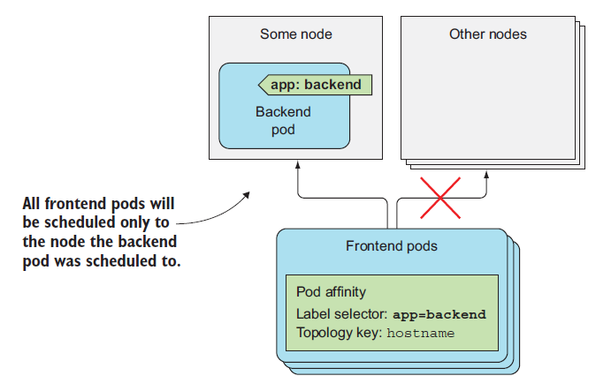
Co-locating Pods with Pod Affinity and Anti-affinity(3/15)
Using Inter-pod Affinity to Deploy Pods on the Same Node :
  The previous listing shows that this Deployment will create pods that have a hard requirement to be deployed on the same node (specified by the “topologyKey” field) as pods that have the “app=backend” label (see the following figure).
  NOTE : Instead of the simpler “matchLabels” field, you could also use the more expressive “matchExpressions” field.

Slide 35
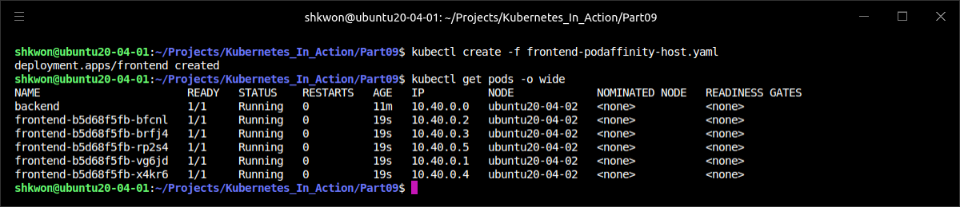
Co-locating Pods with Pod Affinity and Anti-affinity(4/15)
Using Inter-pod Affinity to Deploy Pods on the Same Node :
  Before you create this Deployment, let’s see which node the backend pod was scheduled to earlier :
  When you create the frontend pods, they should be deployed to “ubuntu20-04-02” as well. You’re going to create the Deployment and see where the pods are deployed. This is shown in the next screenshot.

Slide 36
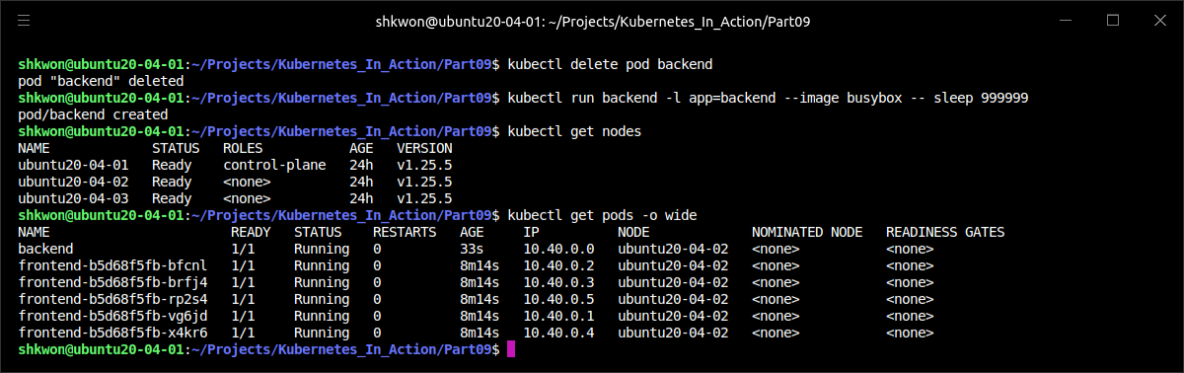
Co-locating Pods with Pod Affinity and Anti-affinity(5/15)
Using Inter-pod Affinity to Deploy Pods on the Same Node :
  All the frontend pods were indeed scheduled to the same node as the backend pod. When scheduling the frontend pod, the Scheduler first found all the pods that match the “labelSelector” defined in the frontend pod’s “podAffinity” configuration and then scheduled the frontend pod to the same node.
  What’s interesting is that if you now delete the backend pod, the Scheduler will schedule the pod to “ubuntu20-04-02” even though it doesn’t define any pod affinity rules itself (the rules are only on the frontend pods). This makes sense, because otherwise if the backend pod were to be deleted by accident and rescheduled to a different node, the frontend pods’ affinity rules would be broken.

Slide 37
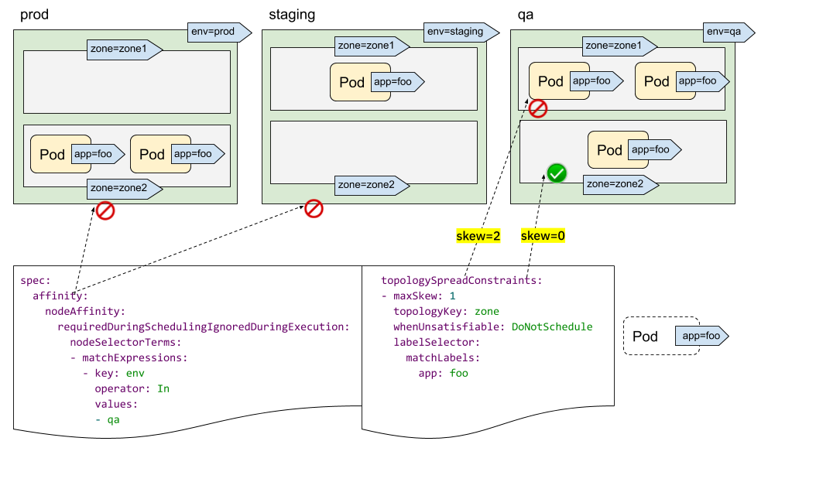
Co-locating Pods with Pod Affinity and Anti-affinity(6/15)
Deploying Pods in the Same Rack, Availability Zone, or Geographic Region :
  In the previous example, you used “podAffinity” to deploy frontend pods onto the same node as the backend pods. You probably don’t want all your frontend pods to run on the same machine, but you’d still like to keep them close to the backend pod—for example, run them in the same availability zone.
  The cluster I’m using runs in three VMs on my local machine, so all the nodes are in the same availability zone, so to speak. But if the nodes were in different zones, all I’d need to do to run the frontend pods in the same zone as the backend pod would be to change the “topologyKey” property to “failure-domain.beta.kubernetes.io/zone”.
  To allow the pods to be deployed in the same region instead of the same zone (cloud providers usually have datacenters located in different geographical regions and split into multiple availability zones in each region), the “topologyKey” would be set to failure-domain.beta.kubernetes.io/region.

Slide 38
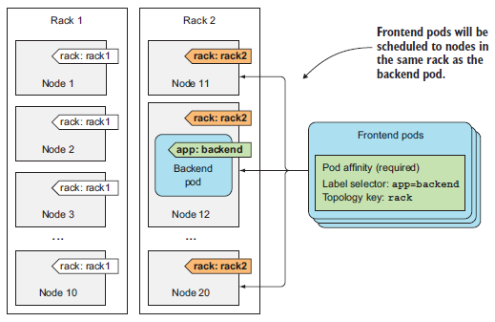
Co-locating Pods with Pod Affinity and Anti-affinity(7/15)
Deploying Pods in the Same Rack, Availability Zone, or Geographic Region :
  The way “topologyKey” works is simple. If you want, you can easily use your own “topologyKey”, such as “rack”, to have the pods scheduled to the same server rack. The only prerequisite is to add a “rack” label to your nodes. This scenario is shown in the following figure.
  For example, if you had 20 nodes, with 10 in each rack, you’d label the first ten as “rack=rack1” and the others as “rack=rack2”. Then, when defining a pod’s “podAffinity”, you’d set the “toplogyKey” to “rack”.

Slide 39
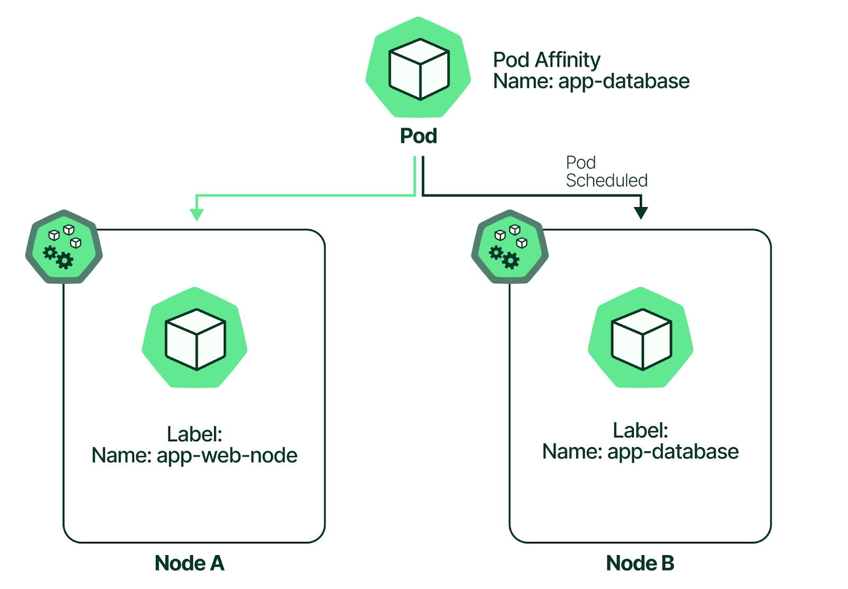
Co-locating Pods with Pod Affinity and Anti-affinity(8/15)
Deploying Pods in the Same Rack, Availability Zone, or Geographic Region :
  When the Scheduler is deciding where to deploy a pod, it checks the pod’s “podAffinity” config, finds the pods that match the label selector, and looks up the nodes they’re running on. Specifically, it looks up the nodes’ label whose key matches the “topologyKey” field specified in “podAffinity”. Then it selects all the nodes whose label matches the values of the pods it found earlier. In the previous figure, the label selector matched the backend pod, which runs on Node 12. The value of the “rack” label on that node equals “rack2”, so when scheduling a frontend pod, the Scheduler will only select among the nodes that have the “rack=rack2” label.
  NOTE : By default, the label selector only matches pods in the same namespace as the pod that’s being scheduled. But you can also select pods from other namespaces by adding a namespaces field at the same level as “labelSelector”.

Slide 40
Co-locating Pods with Pod Affinity and Anti-affinity(9/15)
Expressing Pod Affinity Preferences Instead of Hard Requirements :
  The “nodeAffinity” can be used to express a hard requirement, which means a pod is only scheduled to nodes that match the node affinity rules. It can also be used to specify node preferences, to instruct the Scheduler to schedule the pod to certain nodes, while allowing it to schedule it anywhere else if those nodes can’t fit the pod for any reason.
  The same also applies to “podAffinity”. You can tell the Scheduler you’d prefer to have your frontend pods scheduled onto the same node as your backend pod, but if that’s not possible, you’re okay with them being scheduled elsewhere. An example of a Deployment using the “preferredDuringSchedulingIgnoredDuringExecution” pod affinity rule is shown in the next listing.
apiVersion: apps/v1
kind: Deployment
metadata:
name: frontend
spec:
replicas: 5
template:
metadata:
labels:
app: frontend
spec:
affinity:
podAffinity:
preferredDuringSchedulingIgnoredDuringExecution:
- weight: 80
podAffinityTerm:
topologyKey: kubernetes.io/hostname
labelSelector:
matchLabels:
app: backend
containers:
- name: main
image: busybox
args:
- sleep
- "99999"
selector:
matchLabels:
app: frontend
frontend-podaffinity-preferred-host.yaml

Slide 41
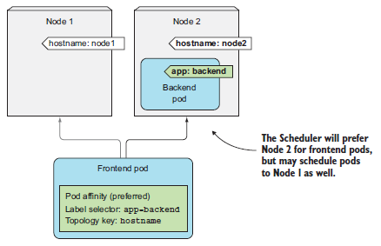
Co-locating Pods with Pod Affinity and Anti-affinity(10/15)
Expressing Pod Affinity Preferences Instead of Hard Requirements :
  As in “nodeAffinity” preference rules, you need to define a “weight” for each rule. You also need to specify the “topologyKey” and “labelSelector”, as in the hard-requirement “podAffinity” rules. The following figure shows this scenario.

Slide 42
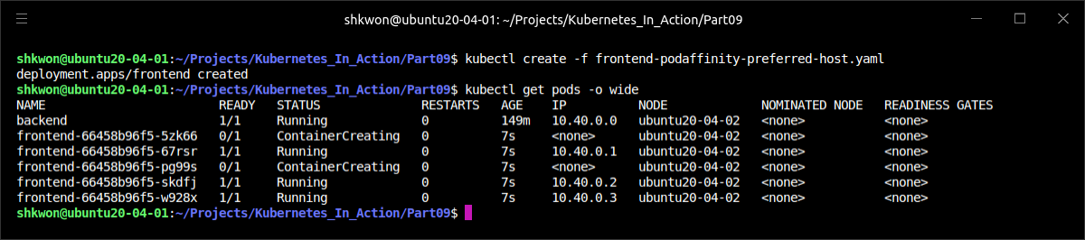
Co-locating Pods with Pod Affinity and Anti-affinity(11/15)
Expressing Pod Affinity Preferences Instead of Hard Requirements :
  Deploying the previous pod, as with your “nodeAffinity” example, deploys four(or five) pods on the same node as the backend pod, and one(or none) pod on the other node (see the following listing).
  NOTE : As you can see from the above screenshot, all five pods are deployed on the same node as the “backend” pod. If you want to deploy more pods, you can make a change in the YAML file. Then you can find some pods are deployed on the other node. Change the “replicas” to “20” and deploy the Pod.
$ kubectl delete -f frontend-podaffinity-host.yaml
$ kubectl create -f frontend-podaffinity-preferred-host.yaml
$ kubectl get pods -o wide

Slide 43
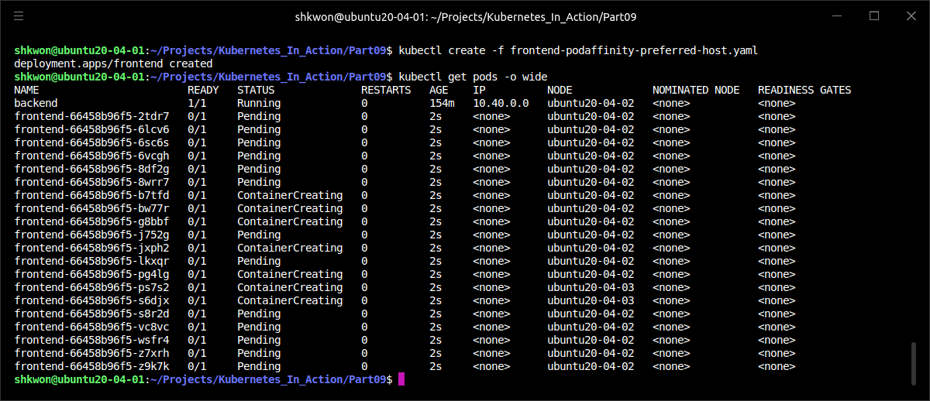
NOTE : Deploying More Pods
Checking the Effect of “weight” Field :
  When you create more pods like 20, then you will see the following screenshot.

Slide 44
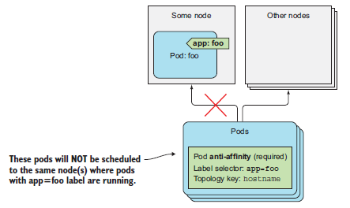
Co-locating Pods with Pod Affinity and Anti-affinity(12/15)
Scheduling Pods away from Each Other with Pod Anti-affinity :
  You may want to keep pods away from each other. This is called “pod anti-affinity”. It’s specified the same way as pod affinity, except that you use the “podAntiAffinity” property instead of podAffinity, which results in the Scheduler never choosing nodes where pods matching the “podAntiAffinity’s label selector” are running, as shown in the following figure.
  An example of why you’d want to use pod anti-affinity is when two sets of pods interfere with each other’s performance if they run on the same node. In that case, you want to tell the Scheduler to never schedule those pods on the same node. Another example would be to force the Scheduler to spread pods of the same group across different availability zones or regions, so that a failure of a whole zone (or region) never brings the service down completely.

Slide 45
Co-locating Pods with Pod Affinity and Anti-affinity(13/15)
Scheduling Pods away from Each Other with Pod Anti-affinity :
  Let’s see how to force your frontend pods to be scheduled to different nodes. The following listing shows how the pods’ “anti-affinity” is configured. This time, you’re defining “podAntiAffinity” instead of “podAffinity”, and you’re making the “labelSelector” match the same pods that the Deployment creates.
apiVersion: apps/v1
kind: Deployment
metadata:
name: frontend
spec:
replicas: 5
template:
metadata:
labels:
app: frontend
spec:
affinity:
podAntiAffinity:
requiredDuringSchedulingIgnoredDuringExecution:
- topologyKey: kubernetes.io/hostname
labelSelector:
matchLabels:
app: frontend
containers:
- name: main
image: busybox
args:
- sleep
- "99999"
selector:
matchLabels:
app: frontend
frontend-podantiaffinity-host.yaml

Slide 46
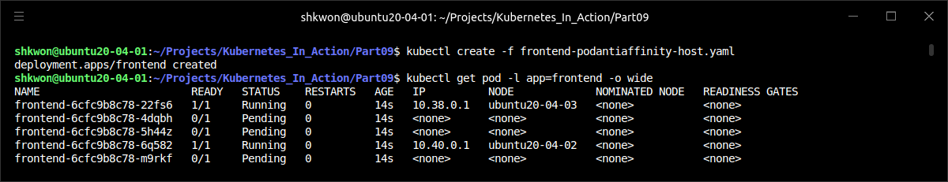
Co-locating Pods with Pod Affinity and Anti-affinity(14/15)
Scheduling Pods away from Each Other with Pod Anti-affinity :
  The pods created by it are shown in the following screenshot.
  As you can see from the above screenshot, only two pods were scheduled—one to “ubuntu20-04-02”, the other to “ubuntu20-04-03”. The three remaining pods are all Pending, because the Scheduler isn’t allowed to schedule them to the same nodes.
$ kubectl delete -f frontend-podaffinity-preferred-host.yaml
$ kubectl create -f frontend-podantiaffinity-host.yaml
$ kubectl get pod -l app=frontend -o wide

Slide 47
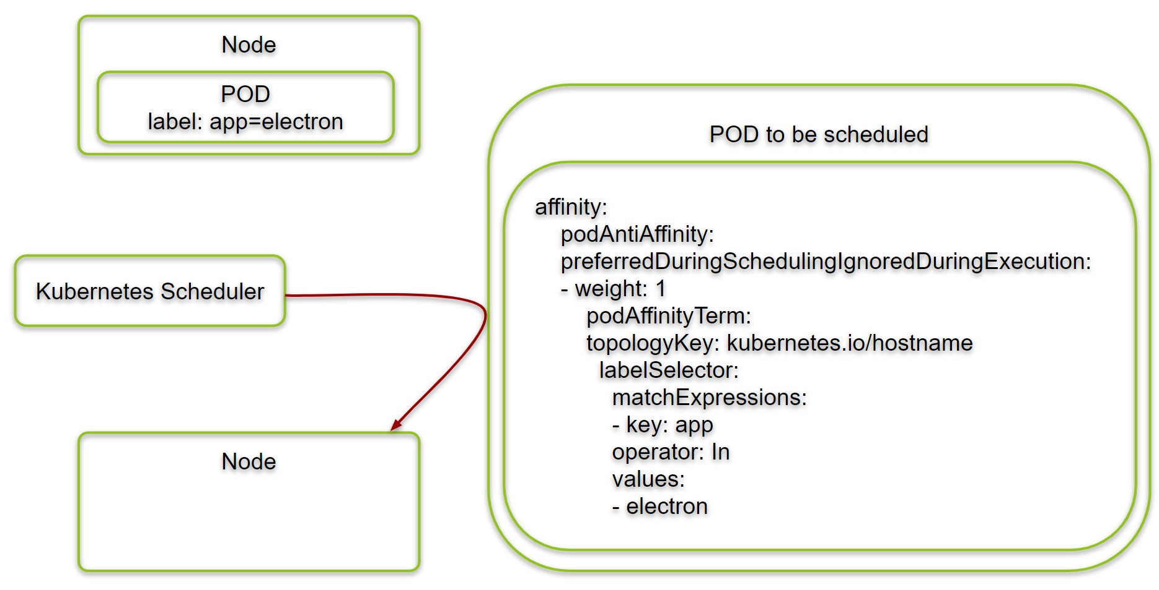
Co-locating Pods with Pod Affinity and Anti-affinity(15/15)
Scheduling Pods away from Each Other with Pod Anti-affinity :
  In the previous example, you probably should have specified a soft requirement instead (using the “preferredDuringSchedulingIgnoredDuringExecution” property). After all, it’s not such a big problem if two frontend pods run on the same node. But in scenarios where that’s a problem, using “requiredDuringScheduling” is appropriate.
  As with pod affinity, the “topologyKey” property determines the scope of where the pod shouldn’t be deployed to. You can use it to ensure pods aren’t deployed to the same rack, availability zone, region, or any custom scope you create using custom node labels.

Slide 48
Best Practices

Slide 49
Bringing Everything Together(1/4)
The Kubernetes Components :
  Let’s start by looking at what an actual application consists of. This will also give you a chance to see if you remember everything you’ve learned so far and look at the big picture. The following figure shows the Kubernetes components used in a typical application.

Slide 50
Bringing Everything Together(2/4)
The Kubernetes Components :
  A typical application manifest contains one or more Deployment and/or StatefulSet objects. Those include a pod template containing one or more containers, with a liveness probe for each of them and a readiness probe for the service(s) the container provides (if any). Pods that provide services to others are exposed through one or more Services. When they need to be reachable from outside the cluster, the Services are either configured to be LoadBalancer or NodePort-type Services, or exposed through an Ingress resource.
  The pod templates (and the pods created from them) usually reference two types of Secrets—those for pulling container images from private image registries and those used directly by the process running inside the pods. The Secrets themselves are usually not part of the application manifest, because they aren’t configured by the application developers but by the operations team. Secrets are usually assigned to ServiceAccounts, which are assigned to individual pods.

Slide 51
Bringing Everything Together(3/4)
The Kubernetes Components :
  The application also contains one or more ConfigMaps, which are either used to initialize environment variables or mounted as a configMap volume in the pod. Certain pods use additional volumes, such as an emptyDir or a gitRepo volume, whereas pods requiring persistent storage use persistentVolumeClaim volumes. The PersistentVolumeClaims are also part of the application manifest, whereas StorageClasses referenced by them are created by system administrators upfront.
  In certain cases, an application also requires the use of Jobs or CronJobs. DaemonSets aren’t normally part of application deployments, but are usually created by sysadmins to run system services on all or a subset of nodes. HorizontalPodAutoscalers are either included in the manifest by the developers or added to the system later by the ops team. The cluster administrator also creates LimitRange and ResourceQuota objects to keep compute resource usage of individual pods and all the pods (as a whole) under control.

Slide 52
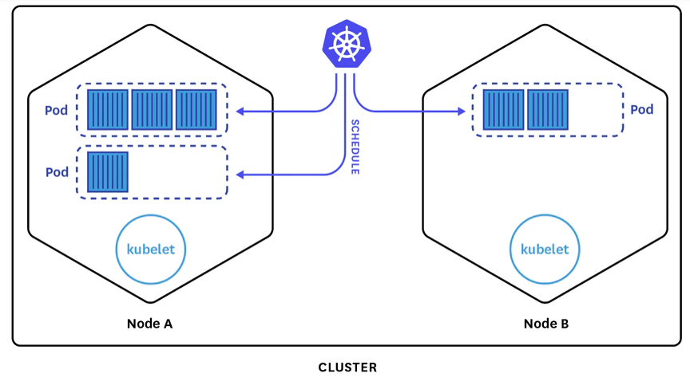
Bringing Everything Together(4/4)
The Kubernetes Components :
  After the application is deployed, additional objects are created automatically by the various Kubernetes controllers. These include service Endpoints objects created by the Endpoints controller, ReplicaSets created by the Deployment controller, and the actual pods created by the ReplicaSet (or Job, CronJob, StatefulSet, or DaemonSet) controllers.
  Resources are often labeled with one or more labels to keep them organized. This doesn’t apply only to pods but to all other resources as well. In addition to labels, most resources also contain annotations that describe each resource, list the contact information of the person or team responsible for it, or provide additional metadata for management and other tools.
  At the center of all this is the Pod, which arguably is the most important Kubernetes resource. After all, each of your applications runs inside it. To make sure you know how to develop apps that make the most out of their environment, let’s take one last close look at pods—this time from the application’s perspective.

Slide 53
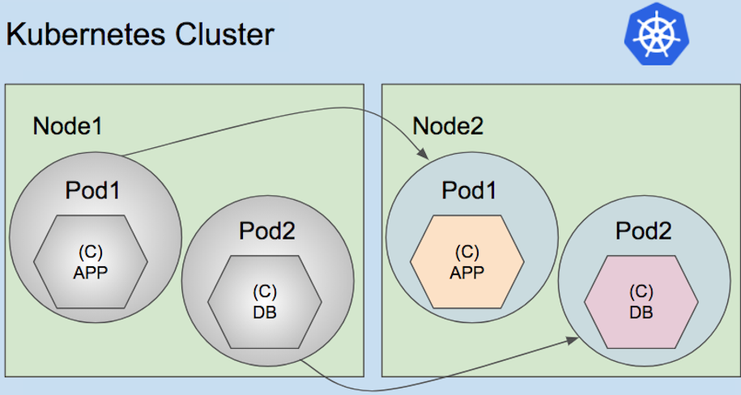
Understanding the Pod’s Lifecycle(1/30)
Applications Must Expect to be Killed and Relocated :
  We’ve said that pods can be compared to VMs dedicated to running only a single application. Although an application running inside a pod is not unlike an application running in a VM, significant differences do exist. One example is that apps running in a pod can be killed any time, because Kubernetes needs to relocate the pod to another node for a reason or because of a scale-down request.
  Outside Kubernetes, apps running in VMs are seldom moved from one machine to another. When an operator moves the app, they can also reconfigure the app and manually check that the app is running fine in the new location. With Kubernetes, apps are relocated much more frequently and automatically—no human operator reconfigures them and makes sure they still run properly after the move. This means application developers need to make sure their apps allow being moved relatively often.

Slide 54
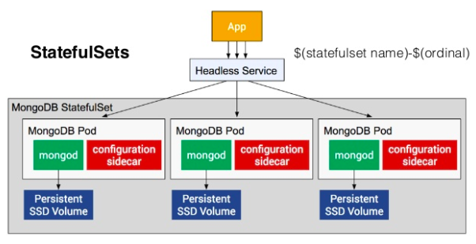
Understanding the Pod’s Lifecycle(2/30)
Expecting the Local IP and Hostname to Change :
  When a pod is killed and run elsewhere (technically, it’s a new pod instance replacing the old one; the pod isn’t relocated), it not only has a new IP address but also a new name and hostname. Most stateless apps can usually handle this without any adverse effects, but stateful apps usually can’t. We’ve learned that stateful apps can be run through a StatefulSet, which ensures that when the app starts up on a new node after being rescheduled, it will still see the same host name and persistent state as before. The pod’s IP will change nevertheless. Apps need to be prepared for that to happen. The application developer therefore should never base membership in a clustered app on the member’s IP address, and if basing it on the hostname, should always use a StatefulSet.

Slide 55
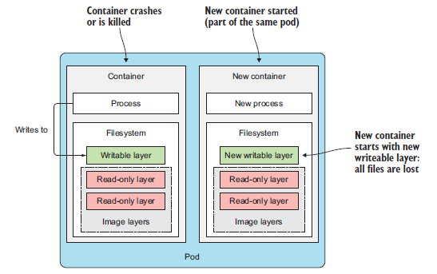
Understanding the Pod’s Lifecycle(3/30)
Expecting the Data Written to Disk to Disappear :
  Another thing to keep in mind is that if the app writes data to disk, that data may not be available after the app is started inside a new pod, unless you mount persistent storage at the location the app is writing to. It should be clear this happens when the pod is rescheduled, but files written to disk will disappear even in scenarios that don’t involve any rescheduling. Even during the lifetime of a single pod, the files written to disk by the app running in the pod may disappear.
  For example, imagine an app that has a long and computationally intensive initial startup procedure. To help the app come up faster on subsequent startups, the developers make the app cache the results of the initial startup on disk (an example of this would be the scanning of all Java classes for annotations at startup and then writing the results to an index file). Because apps in Kubernetes run in containers by default, these files are written to the container’s filesystem. If the container is then restarted, they’re all lost, because the new container starts off with a completely new writable layer (see the following figure).
  Don’t forget that individual containers may be restarted for several reasons, such as because the process crashes, because the liveness probe returned a failure, or because the node started running out of memory and the process was killed by the “OOMKiller(Out Of Memory Killer)”. When this happens, the pod is still the same, but the container itself is completely new. The Kubelet doesn’t run the same container again; it always creates a new container.

Slide 56
Understanding the Pod’s Lifecycle(4/30)
Using Volumes to Preserve Data Across Container Restarts :
  When its container is restarted, the app in the previous example will need to perform the intensive startup procedure again. This may or may not be desired. To make sure data like this isn’t lost, you need to use at least a pod-scoped volume. Because volumes live and die together with the pod, the new container will be able to reuse the data written to the volume by the previous container (See the following figure).
The Pod-Scoped Volume

Slide 57
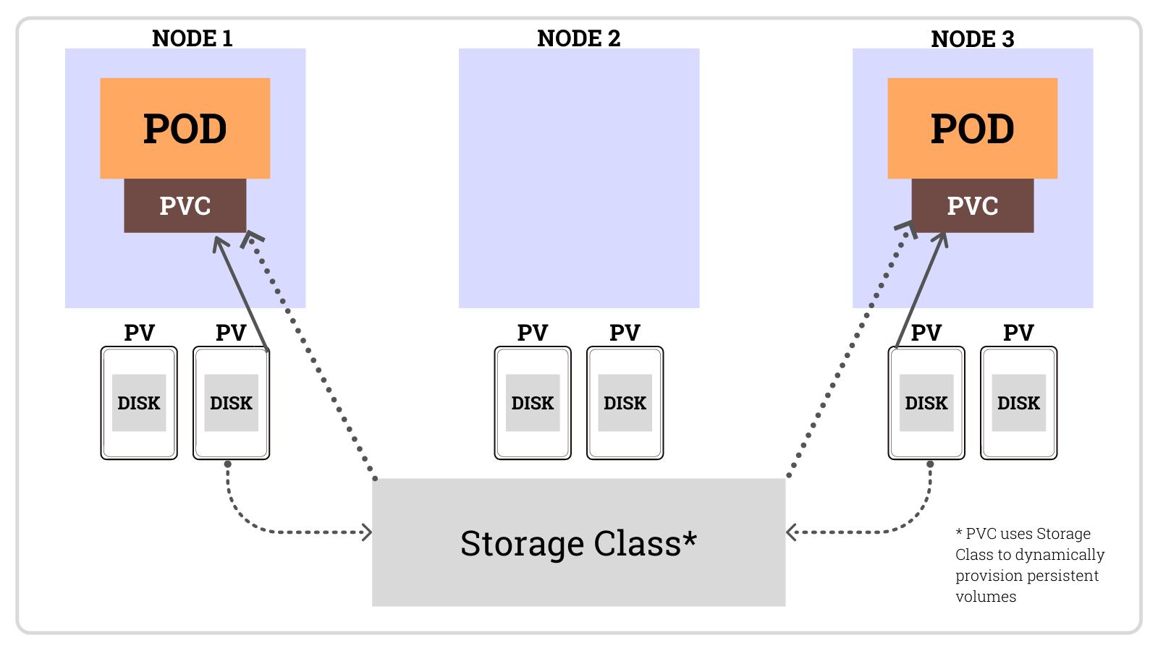
Understanding the Pod’s Lifecycle(5/30)
Using Volumes to Preserve Data Across Container Restarts :
  Using a volume to preserve files across container restarts is a great idea sometimes, but not always. What if the data gets corrupted and causes the newly created process to crash again? This will result in a continuous crash loop (the pod will show the “CrashLoopBackOff” status). If you hadn’t used a volume, the new container would start from scratch and most likely not crash. Using volumes to preserve files across container restarts like this is a double-edged sword. You need to think carefully about whether to use them or not.

Slide 58
Understanding the Pod’s Lifecycle(6/30)
Rescheduling of Dead or Partially Dead Pods :
  If a pod’s container keeps crashing, the Kubelet will keep restarting it indefinitely. The time between restarts will be increased exponentially until it reaches five minutes. During those five minute intervals, the pod is essentially dead, because its container’s process isn’t running. To be fair, if it’s a multi-container pod, certain containers may be running normally, so the pod is only partially dead. But if a pod contains only a single container, the pod is effectively dead and completely useless, because no process is running in it anymore.
  You may find it surprising to learn that such pods aren’t automatically removed and rescheduled, even if they’re part of a ReplicaSet or similar controller. If you create a ReplicaSet with a desired replica count of three, and then one of the containers in one of those pods starts crashing, Kubernetes will not delete and replace the pod. The end result is a ReplicaSet with only two properly running replicas instead of the desired three.

Slide 59
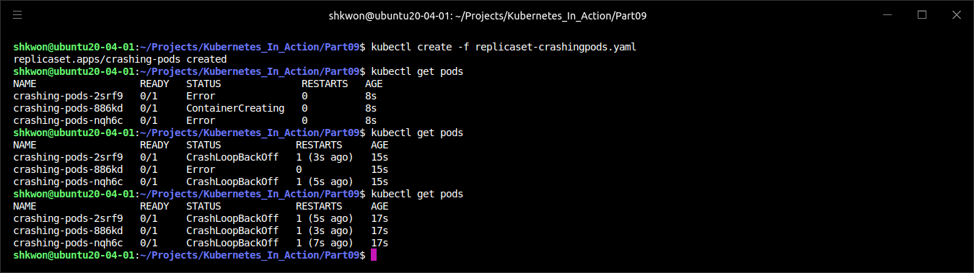
Understanding the Pod’s Lifecycle(7/30)
Rescheduling of Dead or Partially Dead Pods :
  You’d probably expect the pod to be deleted and replaced with another pod instance that might run successfully on another node. After all, the container may be crashing because of a node-related problem that doesn’t manifest itself on other nodes. Sadly, that isn’t the case. The ReplicaSet controller doesn’t care if the pods are dead—all it cares about is that the number of pods matches the desired replica count, which in this case, it does.
  If you’d like to see for yourself, you can find “replicaset-crashingpods.yaml”, a ReplicaSet whose pods will keep crashing. If you create the ReplicaSet and inspect the pods that are created, the following listing is what you’ll see.

Slide 60


Understanding the Pod’s Lifecycle(8/30)
Rescheduling of Dead or Partially Dead Pods :
  In a way, it’s understandable that Kubernetes behaves this way. The container will be restarted every five minutes in the hope that the underlying cause of the crash will be resolved. The rationale is that rescheduling the pod to another node most likely wouldn’t fix the problem anyway, because the app is running inside a container and all the nodes should be mostly equivalent. That’s not always the case, but it is most of the time.

Slide 61

Understanding the Pod’s Lifecycle(9/30)
Starting Pods in a Specific Order :
  One other difference between apps running in pods and those managed manually is that the ops person deploying those apps knows about the dependencies between them. This allows them to start the apps in order.
  When you use Kubernetes to run your multi-pod applications, you don’t have a built-in way to tell Kubernetes to run certain pods first and the rest only when the first pods are already up and ready to serve. Sure, you could post the manifest for the first app and then wait for the pod(s) to be ready before you post the second manifest, but your whole system is usually defined in a single YAML or JSON containing multiple Pods, Services, and other objects.
  The Kubernetes API server does process the objects in the YAML/JSON in the order they’re listed, but this only means they’re written to etcd in that order. You have no guarantee that pods will also be started in that order.
  But you can prevent a pod’s main container from starting until a precondition is met. This is done by including an “init containers” in the pod.

Slide 62

Understanding the Pod’s Lifecycle(10/30)
Introducing Init Containers :
  In addition to regular containers, pods can also include “init” containers. As the name suggests, they can be used to initialize the pod—this often means writing data to the pod’s volumes, which are then mounted into the pod’s main container(s).
  A pod may have any number of “init” containers. They’re executed sequentially and only after the last one completes are the pod’s main containers started. This means “init” containers can also be used to delay the start of the pod’s main container(s)—for example, until a certain precondition is met. An “init” container could wait for a service required by the pod’s main container to be up and ready. When it is, the “init” container terminates and allows the main container(s) to be started. This way, the main container wouldn’t use the service before it’s ready.
  Let’s look at an example of a pod using an “init” container to delay the start of the main container. Remember the “fortune” pod you created before? It’s a web server that returns a fortune quote as a response to client requests. Now, let’s imagine you have a “fortune-client” pod that requires the “fortune Service” to be up and running before its main container starts. You can add an “init” container, which checks whether the Service is responding to requests. Until that’s the case, the “init” container keeps retrying. Once it gets a response, the “init” container terminates and lets the main container start.

Slide 63
Understanding the Pod’s Lifecycle(11/30)
Adding an Init Container to a Pod :
  “Init” containers can be defined in the pod spec like main containers but through the “spec.initContainers” field. You’ll find the complete YAML for the “fortune-client pod” in the repository. The following listing shows the part where the “init” container is defined.
apiVersion: v1
kind: Pod
metadata:
name: fortune-client
spec:
initContainers:
- name: init
image: busybox
command:
- sh
- -c
- 'while true; do echo "Waiting for fortune service to come up..."; wget http://fortune -q -T 1 -O /dev/null >/dev/null 2>/dev/null && break; sleep 1; done; echo "Service is up! Starting main container."'
containers:
- image: busybox
name: main
command:
- sh
- -c
- 'echo "Main container started. Reading fortune very 10 seconds."; while true; do echo "-------------"; wget -q -O - http://fortune; sleep 10; done'
fortune-client.yaml

Slide 64

Understanding the Pod’s Lifecycle(12/30)
Adding an Init Container to a Pod :
  When you deploy this pod, only its “init” container is started. This is shown in the pod’s status when you list pods with “$ kubectl get pod” command :
  The STATUS column shows that zero of one “init” containers have finished. You can see the log of the “init” container with “$ kubectl logs” command :
  When running the “$ kubectl logs” command, you need to specify the name of the “init” container with the “-c” switch (in the example, the name of the pod’s “init” container is “init”, as you can see in previous YAML file.).
  The main container won’t run until you deploy the “fortune Service” and the “fortune-server” pod. You’ll find them in the “fortune-server.yaml” file.

Slide 65


Understanding the Pod’s Lifecycle(13/30)
Adding an Init Container to a Pod :
  When you run the “$ kubectl create -f fortune-server.yaml” command, the logging message will be stop.

Slide 66

Understanding the Pod’s Lifecycle(14/30)
Best Practices for Handling Inter-Pod Dependencies :
  You’ve seen how an “init” container can be used to delay starting the pod’s main container(s) until a precondition is met (making sure the Service the pod depends on is ready, for example), but it’s much better to write apps that don’t require every service they rely on to be ready before the app starts up. After all, the service may also go offline later, while the app is already running.
  The application needs to handle internally the possibility that its dependencies aren’t ready. And don’t forget readiness probes. If an app can’t do its job because one of its dependencies is missing, it should signal that through its readiness probe, so Kubernetes knows it, too, isn’t ready. You’ll want to do this not only because it prevents the app from being added as a service endpoint, but also because the app’s readiness is also used by the “Deployment” controller when performing a rolling update, thereby preventing a rollout of a bad version.

Slide 67
Understanding the Pod’s Lifecycle(15/30)
Adding Lifecycle Hooks :
  We’ve talked about how “init” containers can be used to hook into the startup of the pod, but pods also allow you to define two lifecycle hooks :
    Post-start hooks
    Pre-stop hooks
  These lifecycle hooks are specified per container, unlike “init” containers, which apply to the whole pod. As their names suggest, they’re executed when the container starts and before it stops.
  Lifecycle hooks are similar to liveness and readiness probes in that they can either
    Execute a command inside the container
    Perform an HTTP GET request against a URL

Slide 68

Understanding the Pod’s Lifecycle(16/30)
Using a Post-Start Container Lifecycle Hook :
  A post-start hook is executed immediately after the container’s main process is started. You use it to perform additional operations when the application starts. Sure, if you’re the author of the application running in the container, you can always perform those operations inside the application code itself. But when you’re running an application developed by someone else, you mostly don’t want to (or can’t) modify its source code. Post-start hooks allow you to run additional commands without having to touch the app. These may signal to an external listener that the app is starting, or they may initialize the application so it can start doing its job.
  The hook is run in parallel with the main process. The name might be somewhat misleading, because it doesn’t wait for the main process to start up fully (if the process has an initialization procedure, the Kubelet obviously can’t wait for the procedure to complete, because it has no way of knowing when that is).
  But even though the hook runs asynchronously, it does affect the container in two ways. Until the hook completes, the container will stay in the “Waiting” state with the reason “ContainerCreating”. Because of this, the pod’s status will be “Pending” instead of “Running”. If the hook fails to run or returns a non-zero exit code, the main container will be killed.

Slide 69
Understanding the Pod’s Lifecycle(17/30)
Using a Post-Start Container Lifecycle Hook :
  A pod manifest containing a post-start hook looks like the following listing.
  In the example, the “echo”, “sleep”, and “exit” commands are executed along with the container’s main process as soon as the container is created. Rather than run a command like this, you’d typically run a shell script or a binary executable file stored in the container image.
apiVersion: v1
kind: Pod
metadata:
name: pod-with-poststart-hook
spec:
containers:
- image: knix008/kubia
name: kubia
lifecycle:
postStart:
exec:
command:
- sh
- -c
- "echo 'hook will fail with exit code 15'; sleep 5 ; exit 15"
post-sart-hook.yaml

Slide 70


Understanding the Pod’s Lifecycle(18/30)
Using a Post-Start Container Lifecycle Hook :
  Sadly, if the process started by the hook logs to the standard output, you can’t see the output anywhere. This makes debugging lifecycle hooks painful. If the hook fails, you’ll only see a “FailedPostStartHook” warning among the pod’s events (you can see them using “$ kubectl describe pod” command). A while later, you’ll see more information on why the hook failed, as shown in the following listing.

Slide 71


Understanding the Pod’s Lifecycle(19/30)
Using a Post-Start Container Lifecycle Hook :
  The number “15” in the last line of the previous example is the exit code of the command. When using an “HTTP GET hook handler”, the reason may look like the following listing (you can try this by deploying the “post-start-hook-httpget.yaml” file from the repository).
  NOTE : The post-start hook is intentionally misconfigured to use port “9090” instead of the correct port “8080”, to show what happens when the hook fails.

Slide 72

Understanding the Pod’s Lifecycle(20/30)
Using a Post-Start Container Lifecycle Hook :
  The standard and error outputs of command-based post-start hooks aren’t logged anywhere, so you may want to have the process the hook invokes log to a file in the container’s filesystem, which will allow you to examine the contents of the file with something like this :
  If the container gets restarted for whatever reason (including because the hook failed), the file may be gone before you can examine it. You can work around that by mounting an “emptyDir” volume into the container and having the hook write to it.
$ kubectl exec my-pod cat logfile.txt

Slide 73
Understanding the Pod’s Lifecycle(21/30)
Using a Pre-Stop Container Lifecycle Hook :
  A pre-stop hook is executed immediately before a container is terminated. When a container needs to be terminated, the Kubelet will run the pre-stop hook, if configured, and only then send a SIGTERM to the process (and later kill the process if it doesn’t terminate gracefully).
  A pre-stop hook can be used to initiate a graceful shutdown of the container, if it doesn’t shut down gracefully upon receipt of a SIGTERM signal. They can also be used to perform arbitrary operations before shutdown without having to implement those operations in the application itself (this is useful when you’re running a third-party app, whose source code you don’t have access to and/or can’t modify).
  Configuring a pre-stop hook in a pod manifest isn’t very different from adding a post-start hook. The previous example showed a post-start hook that executes a command, so we’ll look at a pre-stop hook that performs an HTTP GET request now. The following listing shows how to define a “pre-stop HTTP GET hook” in a pod.
apiVersion: v1
kind: Pod
metadata:
name: pod-with-prestop-hook
spec:
containers:
- image: knix008/kubia
name: kubia
ports:
- containerPort: 8080
protocol: TCP
lifecycle:
preStop:
httpGet:
port: 8080
path: shutdown
pre-stop-hook-httpget.yaml

Slide 74

Understanding the Pod’s Lifecycle(22/30)
Using a Pre-Stop Container Lifecycle Hook :
  The pre-stop hook defined in the previous listing performs an “HTTP GET request” to http://POD_IP:8080/shutdown(path) as soon as the Kubelet starts terminating the container. Apart from the port and path shown in the listing, you can also set the fields scheme (“HTTP” or “HTTPS”) and host, as well as “httpHeaders” that should be sent in the request. The “host” field defaults to the pod “IP”. Be sure not to set it to “localhost”, because “localhost” would refer to the node, not the pod.
  In contrast to the post-start hook, the container will be terminated regardless of the result of the hook—an error “HTTP” response code or a non-zero exit code when using a command-based hook will not prevent the container from being terminated. If the pre-stop hook fails, you’ll see a “FailedPreStopHook” warning event among the pod’s events, but because the pod is deleted soon afterward (after all, the pod’s deletion is what triggered the pre-stop hook in the first place), you may not even notice that the pre-stop hook failed to run properly.
  NOTE : If the successful completion of the pre-stop hook is critical to the proper operation of your system, verify whether it’s being executed at all. We can find situations where the pre-stop hook didn’t run and the developer wasn’t even aware of that.

Slide 75

Understanding the Pod’s Lifecycle(23/30)
Using a Pre-Stop Hook Because Your App Doesn’t Receive The SIGTERM Signal :
  Many developers make the mistake of defining a pre-stop hook solely to send a SIGTERM signal to their apps in the pre-stop hook. They do this because they don’t see their application receive the SIGTERM signal sent by the Kubelet. The reason why the signal isn’t received by the application isn’t because Kubernetes isn’t sending it, but because the signal isn’t being passed to the app process inside the container itself. If your container image is configured to run a shell, which in turn runs the app process, the signal may be eaten up by the shell itself, instead of being passed down to the child process.
  In such cases, instead of adding a pre-stop hook to send the signal directly to your app, the proper fix is to make sure the shell passes the signal to the app. This can be achieved by handling the signal in the shell script running as the main container process and then passing it on to the app. Or you could not configure the container image to run a shell at all and instead run the application binary directly. You do this by using the exec form of “ENTRYPOINT” or “CMD” in the “Dockerfile” : “ENTRYPOINT ["/mybinary"]” instead of “ENTRYPOINT /mybinary”.
  A container using the first form runs the “mybinary” executable as its main process, whereas the second form runs a shell as the main process with the “mybinary” process executed as a child of the shell process.

Slide 76
Understanding the Pod’s Lifecycle(24/30)
Understanding That Lifecycle Hooks Target Containers, Not Pods :
  As a final thought on post-start and pre-stop hooks, these lifecycle hooks relate to containers, not pods. You shouldn’t use a pre-stop hook for running actions that need to be performed when the pod is terminating. The reason is that the pre-stop hook gets called when the container is being terminated (most likely because of a failed liveness probe). This may happen multiple times in the pod’s lifetime, not only when the pod is in the process of being shut down.

Slide 77
Understanding the Pod’s Lifecycle(25/30)
Understanding Pod Shutdown :
  A pod’s shut-down is triggered by the deletion of the Pod object through the API server. Upon receiving an “HTTP DELETE request”, the API server doesn’t delete the object yet, but only sets a “deletionTimestamp” field in it. Pods that have the “deletionTimestamp” field set are terminating.
  Once the Kubelet notices the pod needs to be terminated, it starts terminating each of the pod’s containers. It gives each container time to shut down gracefully, but the time is limited. That time is called “the termination grace period” and is configurable per pod. The timer starts as soon as the termination process starts. Then the following sequence of events is performed :
    Run the pre-stop hook, if one is configured, and wait for it to finish.
    Send the SIGTERM signal to the main process of the container.
    Wait until the container shuts down cleanly or until the termination grace period runs out.
    Forcibly kill the process with SIGKILL, if it hasn’t terminated gracefully yet.

Slide 78
Understanding the Pod’s Lifecycle(26/30)
Specifying the Termination Grace Period :
  The termination grace period can be configured in the pod spec by setting the “spec.terminationGracePeriodSeconds” field. It defaults to “30”, which means the pod’s containers will be given 30 seconds to terminate gracefully before they’re killed forcibly.
  NOTE : You should set the grace period to long enough so your process can finish cleaning up in that time.
  The grace period specified in the pod spec can also be overridden when deleting the pod like this :
  This will make the Kubelet wait five seconds for the pod to shut down cleanly. When all the pod’s containers stop, the Kubelet notifies the API server and the Pod resource is finally deleted. You can force the API server to delete the resource immediately, without waiting for confirmation, by setting the grace period to zero and adding the “--force” option like this :
$ kubectl delete pod mypod --grace-period=5
$ kubectl delete pod mypod --grace-period=0 --force

Slide 79

Understanding the Pod’s Lifecycle(27/30)
Specifying the Termination Grace Period :
  Be careful when using “--force” option, especially with pods of a “StatefulSet”. The “StatefulSet” controller takes great care to never run two instances of the same pod at the same time (two pods with the same ordinal index and name and attached to the same “PersistentVolume”). By force-deleting a pod, you’ll cause the controller to create a replacement pod without waiting for the containers of the deleted pod to shut down. In other words, two instances of the same pod might be running at the same time, which may cause your stateful cluster to malfunction. Only delete stateful pods forcibly when you’re absolutely sure the pod isn’t running anymore or can’t talk to the other members of the cluster (you can be sure of this when you confirm that the node that hosted the pod has failed or has been disconnected from the network and can’t reconnect).
terminationGracePeriodSeconds :

Slide 80

Understanding the Pod’s Lifecycle(28/30)
Implementing the Proper Shutdown Handler in Your Application :
  Applications should react to a “SIGTERM” signal by starting their shut-down procedure and terminating when it finishes. Instead of handling the SIGTERM signal, the application can be notified to shut down through a “pre-stop hook”. In both cases, the app then only has a fixed amount of time to terminate cleanly.
  But what if you can’t predict how long the app will take to shut down cleanly? For example, imagine your app is a distributed data store. On scale-down, one of the pod instances will be deleted and therefore shut down. In the shut-down procedure, the pod needs to migrate all its data to the remaining pods to make sure it’s not lost. Should the pod start migrating the data upon receiving a termination signal (through either the SIGTERM signal or through a pre-stop hook)?
  Absolutely not! This is not recommended for at least the following two reasons :
    A container terminating doesn’t necessarily mean the whole pod is being terminated.
    You have no guarantee the shut-down procedure will finish before the process is killed.
  This second scenario doesn’t happen only when the grace period runs out before the application has finished shutting down gracefully, but also when the node running the pod fails in the middle of the container shut-down sequence. Even if the node then starts up again, the Kubelet will not restart the shut-down procedure (it won’t even start up the container again). There are absolutely no guarantees that the pod will be allowed to complete its whole shut-down procedure.

Slide 81

Understanding the Pod’s Lifecycle(29/30)
Replacing Critical Shut-Down Procedures with Dedicated Shut-Down Procedure Pods :
  How do you ensure that a critical shut-down procedure that absolutely must run to completion does run to completion (for example, to ensure that a pod’s data is migrated to other pods)?
  One solution is for the app (upon receipt of a termination signal) to create a new Job resource that would run a new pod, whose sole “job“ is to migrate the deleted pod’s data to the remaining pods. But if you’ve been paying attention, you’ll know that you have no guarantee the app will indeed manage to create the Job object every single time. What if the node fails exactly when the app tries to do that?
  The proper way to handle this problem is by having a dedicated, constantly running pod that keeps checking for the existence of orphaned data. When this pod finds the orphaned data, it can migrate it to the remaining pods. Rather than a constantly running pod, you can also use a “CronJob” resource and run the pod periodically.

Slide 82
Understanding the Pod’s Lifecycle(30/30)
Replacing Critical Shut-Down Procedures with Dedicated Shut-Down Procedure Pods :
  You may think “StatefulSets” could help here, but they don’t. As you’ll remember, scaling down a “StatefulSet” leaves “PersistentVolumeClaims” orphaned, leaving the data stored on the “PersistentVolume” stranded. Yes, upon a subsequent scale-up, the “PersistentVolume” will be reattached to the new pod instance, but what if that scale-up never happens (or happens after a long time)? For this reason, you may want to run a “data-migrating pod” also when using “StatefulSets”(show in the following figure). To prevent the migration from occurring during an application upgrade, the data-migrating pod could be configured to wait a while to give the stateful pod time to come up again before performing the migration.

Slide 83

Ensuring All Client Requests Are Handled Properly(1/10)
Preventing Broken Client Connections When a Pod is Starting Up :
  Ensuring each connection is handled properly at pod startup is simple if you understand how Services and service Endpoints work. When a pod is started, it’s added as an endpoint to all the Services, whose label selector matches the pod’s labels. The pod also needs to signal to Kubernetes that it’s ready. Until it is, it won’t become a service endpoint and therefore won’t receive any requests from clients.
  If you don’t specify a readiness probe in your pod spec, the pod is always considered ready. It will start receiving requests almost immediately—as soon as the first kube-proxy updates the iptables rules on its node and the first client pod tries to connect to the service. If your app isn’t ready to accept connections by then, clients will see “connection refused” types of errors.
  All you need to do is make sure that your readiness probe returns success only when your app is ready to properly handle incoming requests. A good first step is to add an HTTP GET readiness probe and point it to the base URL of your app. In many cases that gets you far enough and saves you from having to implement a special readiness endpoint in your app.

Slide 84

Ensuring All Client Requests Are Handled Properly(2/10)
Preventing Broken Connection During Pod Shut-Down :
  When the pod is deleted and its containers are terminated. We’ve already talked about how the pod’s containers should start shutting down cleanly as soon they receive the SIGTERM signal (or when its pre-stop hook is executed). But does that ensure all client requests are handled properly?
  How should the app behave when it receives a termination signal? Should it continue to accept requests? What about requests that have already been received but haven’t completed yet? What about persistent HTTP connections, which may be in between requests, but are open (when no active request exists on the connection)? Before we can answer those questions, we need to take a detailed look at the chain of events that unfolds across the cluster when a Pod is deleted.

Slide 85
Ensuring All Client Requests Are Handled Properly(3/10)
Understanding the Sequence of Events Occurring at Pod Deletion :
  You need to always keep in mind that Kubernetes components run as separate processes on multiple machines. They aren’t all part of a single big monolithic process. It takes time for all the components to be on the same page regarding the state of the cluster. Let’s explore this fact by looking at what happens across the cluster when a Pod is deleted.
  When a request for a pod deletion is received by the API server, it first modifies the state in “etcd” and then notifies its watchers of the deletion. Among those watchers are the “Kubelet” and the “Endpoints” controller. The two sequences of events, which happen in parallel (marked with either “A” or “B”), are shown in the following figure.

Slide 86
Ensuring All Client Requests Are Handled Properly(4/10)
Understanding the Sequence of Events Occurring at Pod Deletion :
  In the “A” sequence of events, you’ll see that as soon as the “Kubelet” receives the notification that the pod should be terminated, it initiates the shutdown sequence (run the pre-stop hook, send SIGTERM, wait for a period of time, and then forcibly kill the container if it hasn’t yet terminated on its own). If the app responds to the SIGTERM by immediately ceasing to receive client requests, any client trying to connect to it will receive a “Connection Refused” error. The time it takes for this to happen from the time the pod is deleted is relatively short because of the direct path from the API server to the Kubelet.

Slide 87

Ensuring All Client Requests Are Handled Properly(5/10)
Understanding the Sequence of Events Occurring at Pod Deletion :
  Now, let’s look at what happens in the other sequence of events—the one leading up to the pod being removed from the iptables rules (sequence “B” in the figure). When the Endpoints controller (which runs in the Controller Manager in the Kubernetes Control Plane) receives the notification of the Pod being deleted, it removes the pod as an endpoint in all services that the pod is a part of. It does this by modifying the “Endpoints API” object by sending a REST request to the API server. The API server then notifies all clients watching the Endpoints object. Among those watchers are all the “kube-proxies” running on the worker nodes. Each of these proxies then updates the iptables rules on its node, which is what prevents new connections from being forwarded to the terminating pod. An important detail here is that removing the iptables rules has no effect on existing connections—clients who are already connected to the pod will still send additional requests to the pod through those existing connections.

Slide 88
Ensuring All Client Requests Are Handled Properly(6/10)
Understanding the Sequence of Events Occurring at Pod Deletion :
  Both of these sequences of events happen in parallel. Most likely, the time it takes to shut down the app’s process in the pod is slightly shorter than the time required for the iptables rules to be updated. The chain of events that leads to iptables rules being updated is considerably longer (see the following figure), because the event must first reach the “Endpoints” controller, which then sends a new request to the “API server”, and then the API server must notify the “kube-proxy” before the proxy finally modifies the iptables rules. A high probability exists that the “SIGTERM” signal will be sent well before the iptables rules are updated on all nodes.
  The end result is that the pod may still receive client requests after it was sent the termination signal. If the app closes the server socket and stops accepting connections immediately, this will cause clients to receive “Connection Refused” types of errors (similar to what happens at pod startup if your app isn’t capable of accepting connections immediately and you don’t define a readiness probe for it).

Slide 89

Ensuring All Client Requests Are Handled Properly(7/10)
Solving the Problem :
  Googling solutions to the previous problem makes it seem as though adding a readiness probe to your pod will solve the problem. Supposedly, all you need to do is make the readiness probe start failing as soon as the pod receives the SIGTERM. This is supposed to cause the pod to be removed as the endpoint of the service. But the removal would happen only after the readiness probe fails for a few consecutive times (this is configurable in the readiness probe spec). And, obviously, the removal then still needs to reach the “kube-proxy” before the pod is removed from iptables rules.
  In reality, the readiness probe has absolutely no bearing on the whole process at all. The “Endpoints” controller removes the pod from the “service Endpoints” as soon as it receives notice of the pod being deleted (when the “deletionTimestamp field” in the pod’s spec is no longer null). From that point on, the result of the readiness probe is irrelevant.

Slide 90

Ensuring All Client Requests Are Handled Properly(8/10)
Solving the Problem :
  What’s the proper solution to the problem? How can you make sure all requests are handled fully?
  It’s clear the pod needs to keep accepting connections even after it receives the termination signal up until all the “kube-proxies” have finished updating the iptables rules. Well, it’s not only the “kube-proxies”. There may also be “Ingress controllers” or “load balancers” forwarding connections to the pod directly, without going through the Service (iptables). This also includes clients using client-side load-balancing. To ensure none of the clients experience broken connections, you’d have to wait until all of them somehow notify you they’ll no longer forward connections to the pod.
  That’s impossible, because all those components are distributed across many different computers. Even if you knew the location of every one of them and could wait until all of them say it’s okay to shut down the pod, what do you do if one of them doesn’t respond? How long do you wait for the response? Remember, during that time, you’re holding up the shut-down process.
  The only reasonable thing you can do is wait for a long-enough time to ensure all the proxies have done their job. But how long is long enough? A few seconds should be enough in most situations, but there’s no guarantee it will suffice every time. When the API server or the Endpoints controller is overloaded, it may take longer for the notification to reach the kube-proxy. It’s important to understand that you can’t solve the problem perfectly, but even adding a 5- or 10-second delay should improve the user experience considerably. You can use a longer delay, but don’t go overboard, because the delay will prevent the container from shutting down promptly and will cause the pod to be shown in lists long after it has been deleted, which is always frustrating to the user deleting the pod.

Slide 91
Ensuring All Client Requests Are Handled Properly(9/10)
Wrapping Up :
  To recap(summarize)—properly shutting down an application includes these steps :
    Wait for a few seconds, then stop accepting new connections.
    Close all keep-alive connections not in the middle of a request.
    Wait for all active requests to finish.
    Then shut down completely.
  To understand what’s happening with the connections and requests during this process, examine the following figure carefully.

Slide 92
Ensuring All Client Requests Are Handled Properly(10/10)
Wrapping Up :
  Not as simple as exiting the process immediately upon receiving the termination signal, right? Is it worth going through all this? That’s for you to decide. But the least you can do is add a pre-stop hook that waits a few seconds, like the one in the following listing, perhaps.
  This way, you don’t need to modify the code of your app at all. If your app already ensures all in-flight requests are processed completely, this pre-stop delay may be all you need.
lifecycle:
preStop:
exec:
command:
- sh
- -c
- "sleep 5"
sleep 5

Slide 93
Making Your Apps Easy to Run and Manage in Kubernetes(1/13)
Making Manageable Container Images :
  When you package your app into an image, you can choose to include the app’s binary executable and any additional libraries it needs, or you can package up a whole OS filesystem along with the app. Way too many people do this, even though it’s usually unnecessary.
  Do you need every single file from an OS distribution in your image? Probably not. Most of the files will never be used and will make your image larger than it needs to be. Sure, the layering of images makes sure each individual layer is downloaded only once, but even having to wait longer than necessary the first time a pod is scheduled to a node is undesirable.
  Deploying new pods and scaling them should be fast. This demands having small images without unnecessary cruft. If you’re building apps using the “Go” language, your images don’t need to include anything else apart from the app’s single binary executable file. This makes Go-based container images extremely small and perfect for Kubernetes.
  NOTE : Use the “FROM scratch” directive in the “Dockerfile” for these images.
  But in practice, you’ll soon see these minimal images are extremely difficult to debug. The first time you need to run a tool such as “ping”, “dig(DNS Lookup Utility)”, “curl”, or something similar inside the container, you’ll realize how important it is for container images to also include at least a limited set of these tools. I can’t tell you what to include and what not to include in your images, because it depends on how you do things, so you’ll need to find the sweet spot yourself.

Slide 94

Making Your Apps Easy to Run and Manage in Kubernetes(2/13)
Properly Tagging Your Images and Using imagePullPolicy Wisely :
  You’ll also soon learn that referring to the latest image tag in your pod manifests will cause problems, because you can’t tell which version of the image each individual pod replica is running. Even if initially all your pod replicas run the same image version, if you push a new version of the image under the latest tag, and then pods are rescheduled (or you scale up your Deployment), the new pods will run the new version, whereas the old ones will still be running the old one. Also, using the latest tag makes it impossible to roll back to a previous version (unless you push the old version of the image again).
  It’s almost mandatory to use tags containing a proper version designator instead of latest, except maybe in development. Keep in mind that if you use mutable tags (you push changes to the same tag), you’ll need to set the “imagePullPolicy” field in the pod spec to Always. But if you use that in production pods, be aware of the big caveat associated with it. If the image pull policy is set to “Always”, the container runtime will contact the image registry every time a new pod is deployed. This slows down pod startup a bit, because the node needs to check if the image has been modified. Worse yet, this policy prevents the pod from starting up when the registry cannot be contacted.

Slide 95
Making Your Apps Easy to Run and Manage in Kubernetes(3/13)
Using Multi-Dimensional Instead of Single-Dimensional Labels :
  Don’t forget to label all your resources, not only Pods. Make sure you add multiple labels to each resource, so they can be selected across each individual dimension. You (or the ops team) will be grateful you did it when the number of resources increases.
  Labels may include things like :
    The name of the application (or perhaps microservice) the resource belongs to
    Application tier (front-end, back-end, and so on)
    Environment (development, QA, staging, production, and so on)
    Version
    Type of release (stable, canary, green or blue for green/blue deployments, and so on)
    Tenant (if you’re running separate pods for each tenant instead of using namespaces)
    Shard for sharded systems
  This will allow you to manage resources in groups instead of individually and make it easy to see where each resource belongs.

Slide 96
Making Your Apps Easy to Run and Manage in Kubernetes(4/13)
Describing Each Resource Through Annotations :
  To add additional information to your resources use annotations. At the least, resources should contain an annotation describing the resource and an annotation with contact information of the person responsible for it.
  In a microservices architecture, pods could contain an annotation that lists the names of the other services the pod is using. This makes it possible to show dependencies between pods. Other annotations could include build and version information and metadata used by tooling or graphical user interfaces (icon names, and so on).
  Both labels and annotations make managing running applications much easier, but nothing is worse than when an application starts crashing and you don’t know why.

Slide 97
Making Your Apps Easy to Run and Manage in Kubernetes(5/13)
Providing Information on Why The Process Terminated :
  Nothing is more frustrating than having to figure out why a container terminated (or is even terminating continuously), especially if it happens at the worst possible moment. Be nice to the ops people and make their lives easier by including all the necessary debug information in your log files.
  But to make triage even easier, you can use one other Kubernetes feature that makes it possible to show the reason why a container terminated in the pod’s status. You do this by having the process write a termination message to a specific file in the container’s filesystem. The contents of this file are read by the Kubelet when the container terminates and are shown in the output of “$ kubectl describe pod” command. If an application uses this mechanism, an operator can quickly see why the app terminated without even having to look at the container logs.
  The default file the process needs to write the message to is “/dev/termination-log”, but it can be changed by setting the “terminationMessagePath” field in the container definition in the pod spec.
  You can see this in action by running a pod whose container dies immediately, as shown in the following listing.
apiVersion: v1
kind: Pod
metadata:
name: pod-with-termination-message
spec:
containers:
- image: busybox
name: main
command:
- sh
- -c
- 'echo "I''ve had enough" > /var/termination-reason ; exit 1'
terminationMessagePath: /var/termination-reason
termination-message.yaml

Slide 98


Making Your Apps Easy to Run and Manage in Kubernetes(6/13)
Providing Information on Why The Process Terminated :
  When running this pod, you’ll soon see the pod’s status shown as “CrashLoopBackOff”. If you then use “$ kubectl describe” command, you can see why the container died, without having to dig down into its logs, as shown in the following listing.

Slide 99


Making Your Apps Easy to Run and Manage in Kubernetes(7/13)
Providing Information on Why The Process Terminated :
  As you can see, the “I’ve had enough” message the process wrote to the file “/var/termination-reason” is shown in the container’s “Last State” section. Note that this mechanism isn’t limited only to containers that crash. It can also be used in pods that run a completable task and terminate successfully(you’ll find an example in the file “termination-message-success.yaml”).

Slide 100

Making Your Apps Easy to Run and Manage in Kubernetes(8/13)
Providing Information on Why The Process Terminated :
  This mechanism is great for terminated containers, but you’ll probably agree that a similar mechanism would also be useful for showing app-specific status messages of running, not only terminated, containers. Kubernetes currently doesn’t provide any such functionality.
  NOTE : If the container doesn’t write the message to any file, you can set the “terminationMessagePolicy” field to “FallbackToLogsOnError”. In that case, the last few lines of the container’s log are used as its termination message (but only when the container terminates unsuccessfully).

Slide 101

Making Your Apps Easy to Run and Manage in Kubernetes(9/13)
Handling Application Logs :
  While we’re on the subject of application logging, let’s reiterate that apps should write to the standard output instead of files. This makes it easy to view logs with the “$ kubectl logs” command.
  NOTE : If a container crashes and is replaced with a new one, you’ll see the new container’s log. To see the previous container’s logs, use the “--previous” option with “$ kubectl logs” command.
  If the application logs to a file instead of the standard output, you can display the log file using an alternative approach :
  This executes the “cat” command inside the container and streams the logs back to “kubectl”, which prints them out in your terminal.
  NOTE : Add “--” in front of the “cat” command.
$ kubectl exec <pod> -- cat <logfile>

Slide 102

Making Your Apps Easy to Run and Manage in Kubernetes(10/13)
Copying Log and Other Files to and from a Container :
  You can also copy the log file to your local machine using the “$ kubectl cp” command, which we haven’t looked at yet. It allows you to copy files from and into a container. For example, if a pod called “foo-pod” and its single container contains a file at “/var/log/foo.log”, you can transfer it to your local machine with the following command :
  To copy a file from your local machine into the pod, specify the pod’s name in the second argument :
  This copies the file “localfile” to “/etc/remotefile” inside the pod’s container. If the pod has more than one container, you specify the container using the “-c containerName” option.
$ kubectl cp foo-pod:/var/log/foo.log foo.log
$ kubectl cp localfile foo-pod:/etc/remotefile

Slide 103

Making Your Apps Easy to Run and Manage in Kubernetes(11/13)
Using Centralized Logging :
  In a production system, you’ll want to use a centralized, cluster-wide logging solution, so all your logs are collected and (permanently) stored in a central location. This allows you to examine historical logs and analyze trends. Without such a system, a pod’s logs are only available while the pod exists. As soon as it’s deleted, its logs are deleted also.
  Kubernetes by itself doesn’t provide any kind of centralized logging. The components necessary for providing a centralized storage and analysis of all the container logs must be provided by additional components, which usually run as regular pods in the cluster.
  Deploying centralized logging solutions is easy. All you need to do is deploy a few “YAML/JSON” manifests and you’re good to go. On Google Kubernetes Engine(GKE), it’s even easier. Check the “Enable Stackdriver Logging” checkbox when setting up the cluster. Setting up centralized logging on an on-premises Kubernetes cluster is beyond the scope of this presentation, but we will see a quick overview of how it’s usually done.

Slide 104

Making Your Apps Easy to Run and Manage in Kubernetes(12/13)
Using Centralized Logging :
  You may have already heard of the “ELK” stack composed of “ElasticSearch”, “Logstash”, and “Kibana”. A slightly modified variation is the “EFK(Elasticsearch, Fluentd, Kibana)” stack, where “Logstash” is replaced with “FluentD”.
  When using the “EFK” stack for centralized logging, each Kubernetes cluster node runs a “FluentD” agent (usually as a pod deployed through a “DaemonSet”), which is responsible for gathering the logs from the containers, tagging them with pod-specific information, and delivering them to ElasticSearch, which stores them persistently. ElasticSearch is also deployed as a pod somewhere in the cluster. The logs can then be viewed and analyzed in a web browser through Kibana, which is a web tool for visualizing ElasticSearch data. It also usually runs as a pod and is exposed through a Service. The three components of the EFK stack are shown in the following figure.

Slide 105

Making Your Apps Easy to Run and Manage in Kubernetes(13/13)
Handling Multi-Line Log Statements :
  The “FluentD” agent stores each line of the log file as an entry in the “ElasticSearch” data store. There’s one problem with that. Log statements spanning multiple lines, such as exception stack traces in Java, appear as separate entries in the centralized logging system.
  To solve this problem, you can have the apps output JSON instead of plain text. This way, a multiline log statement can be stored and shown in “Kibana” as a single entry. But that makes viewing logs with kubectl logs much less human-friendly.
  The solution may be to keep outputting human-readable logs to standard output, while writing JSON logs to a file and having them processed by “FluentD”. This requires configuring the “node-level FluentD agent” appropriately or adding a logging sidecar container to every pod.

Slide 106

Best Practices for Development and Testing(1/10)
Running Apps Outside of Kubernetes During Development :
  Having to build the app after each minor change, then build the container image, push it to a registry, and then re-deploy the pods would make development slow and painful. Luckily, you don’t need to go through all that trouble.
  You can always develop and run apps on your local machine, the way you’re used to. After all, an app running in Kubernetes is a regular (although isolated) process running on one of the cluster nodes. If the app depends on certain features the Kubernetes environment provides, you can easily replicate that environment on your development machine.
  Most of the time, you can usually run the app directly from your IDE.

Slide 107

Best Practices for Development and Testing(2/10)
Connecting to Backend Services :
  In production, if the app connects to a backend Service and uses the “BACKEND_SERVICE_HOST” and “BACKEND_SERVICE_PORT” environment variables to find the Service’s coordinates, you can obviously set those environment variables on your local machine manually and point them to the backend Service, regardless of if it’s running outside or inside a Kubernetes cluster. If it’s running inside Kubernetes, you can always (at least temporarily) make the Service accessible externally by changing it to a “NodePort” or a “LoadBalancer”-type Service.

Slide 108

Best Practices for Development and Testing(3/10)
Connecting to the API Server :
  Similarly, if your app requires access to the “Kubernetes API server” when running inside a Kubernetes cluster, it can easily talk to the “API server” from outside the cluster during development. If it uses the “ServiceAccount’s token” to authenticate itself, you can always copy the “ServiceAccount’s Secret’s files” to your local machine with “$ kubectl cp” command. The API server doesn’t care if the client accessing it is inside or outside the cluster.
  If the app uses an “ambassador container” like the one described before, you don’t even need those “Secret files”. Run “kubectl proxy” on your local machine, run your app locally, and it should be ready to talk to your local “kubectl proxy” (as long as it and the ambassador container bind the proxy to the same port).
  In this case, you’ll need to make sure the user account your local “kubectl” is using has the same privileges as the “ServiceAccount” the app will run under.

Slide 109

Best Practices for Development and Testing(4/10)
Running Inside a Container Even During Development :
  When during development you absolutely have to run the app in a container for whatever reason, there is a way of avoiding having to build the container image every time. Instead of baking the binaries into the image, you can always mount your local filesystem into the container through Docker volumes, for example. This way, after you build a new version of the app’s binaries, all you need to do is restart the container (or not even that, if hot-redeploy is supported). No need to rebuild the image.

Slide 110

Best Practices for Development and Testing(5/10)
Using Minikube in Development :
  As you can see, nothing forces you to run your app inside Kubernetes during development. But you may do that anyway to see how the app behaves in a true Kubernetes environment.
  You may have used “Minikube” to run examples in this presentation. Although a “Minikube” cluster runs only a single worker node, it’s nevertheless a valuable method of trying out your app in Kubernetes (and, of course, developing all the resource manifests that make up your complete application). “Minikube” doesn’t offer everything that a proper multi-node Kubernetes cluster usually provides, but in most cases, that doesn’t matter.
  When you’re developing with “Minikube” and you’d like to try out every change to your app in your Kubernetes cluster, you can mount your local filesystem into the “Minikube VM” using the “$ minikube mount” command and then mount it into your containers through a “hostPath” volume. You’ll find additional instructions on how to do that in the “Minikube” documentation https://minikube.sigs.k8s.io/docs/.

Slide 111

Best Practices for Development and Testing(6/10)
Using the Docker Daemon Inside the Minikube VM to Build Your Images :
  If you’re developing your app with “Minikube” and planning to build the container image after every change, you can use the Docker daemon inside the “Minikube VM” to do the building, instead of having to build the image through your local Docker daemon, push it to a registry, and then have it pulled by the daemon in the VM.
  To use “Minikube’s Docker daemon”, all you need to do is point your “DOCKER_HOST” environment variable to it. Luckily, this is much easier than it sounds. All you need to do is run the following command on your local machine :
  This will set all the required environment variables for you. You then build your images the same way as if the Docker daemon was running on your local machine. After you build the image, you don’t need to push it anywhere, because it’s already stored locally on the “Minikube VM”, which means new pods can use the image immediately. If your pods are already running, you either need to delete them or kill their containers so they’re restarted.
$ eval $(minikube docker-env)

Slide 112

Best Practices for Development and Testing(7/10)
Building Images Locally and Copying Them Over to the Minikube VM Directly :
  If you can’t use the daemon inside the VM to build the images, you still have a way to avoid having to push the image to a registry and have the Kubelet running in the Minikube VM pull it. If you build the image on your local machine, you can copy it over to the “Minikube VM” with the following command :
  As before, the image is immediately ready to be used in a pod. But make sure the “imagePullPolicy” in your pod spec isn’t set to “Always”, because that would cause the image to be pulled from the external registry again and you’d lose the changes you’ve copied over.
$ docker save <image> | (eval $(minikube docker-env) && docker load)

Slide 113
Best Practices for Development and Testing(8/10)
Combining Minikube with a Proper Kubernetes Cluster :
  You have virtually no limit when developing apps with Minikube. You can even combine a Minikube cluster with a proper Kubernetes cluster. You can run your development workloads in your local “Minikube” cluster and have them talk to my other workloads that are deployed in a remote multi-node Kubernetes cluster thousands of miles away.
  Once you are finished with development, you can move your local workloads to the remote cluster with no modifications and with absolutely no problems thanks to how Kubernetes abstracts away the underlying infrastructure from the app.

Slide 114

Best Practices for Development and Testing(9/10)
Versioning and Auto-Deploying Resource Manifests :
  Because Kubernetes uses a declarative model, you never have to figure out the current state of your deployed resources and issue imperative commands to bring that state to what you desire. All you need to do is tell Kubernetes your desired state and it will take all the necessary actions to reconcile the cluster state with the desired state.
  You can store your collection of resource manifests in a “Version Control System(VCS)”, enabling you to perform code reviews, keep an audit trail, and roll back changes whenever necessary. After each commit, you can run the “$ kubectl apply” command to have your changes reflected in your deployed resources.
  If you run an agent that periodically (or when it detects a new commit) checks out your manifests from the Version Control System (VCS), and then runs the apply command, you can manage your running apps simply by committing changes to the VCS without having to manually talk to the Kubernetes API server. Luckily, the people at Box (which coincidently was used to host this presentation’s manuscript and other materials) developed and released a tool called “kube-applier”. You’ll find the tool’s source code at https://github.com/box/kube-applier.
  You can use multiple branches to deploy the manifests to a development, QA, staging, and production cluster (or in different namespaces in the same cluster).

Slide 115

Best Practices for Development and Testing(10/10)
Employing Continuous Integration and Continuous Delivery (CI/CD) :
  We’ve touched on automating the deployment of Kubernetes resources, but you may want to set up a complete CI/CD pipeline for building your application binaries, container images, and resource manifests and then deploying them in one or more Kubernetes clusters.
  You’ll find many online resources talking about this subject. “Fabric8 project” (http://fabric8.io) is an integrated development platform for Kubernetes(but now it is disconnected in 2023.04. In this site, you can find some more archived materials). It includes “Jenkins”, the well-known, opensource automation system, and various other tools to deliver a full CI/CD pipeline for DevOps-style development, deployment, and management of microservices on Kubernetes.
  If you’d like to build your own solution, you can refer to the Google Cloud Platform’s online labs that talks about this subject. It’s available at https://github.com/GoogleCloudPlatform/continuous-deployment-on-kubernetes.

Slide 116

NOTE : Big Picture - The Kubernetes Cluster

Slide 117

NOTE : Kubernetes Cheat Sheet

Slide 118

Reference
[1] Kubernetes in Action, Marko Luksa, Manning, 2018 1st Edition.
[2] https://github.com/luksa/kubernetes-in-action
[3] https://minikube.sigs.k8s.io/docs/
[4] https://kubernetes.io/docs/reference/kubectl/cheatsheet/

Slide 119

? & !

